Slide 1
Hemolytic anemia
Engin KELKİTLİ MD
2026
Notes:
Hemolytic anemias are a group of conditions characterized by the breakdown of red blood cells.

Slide 2
Hemolytic Anemias
Mean life span of a RBC 120 days

Slide 3
Introduction
Hemolytic anemias are characterized by premature destruction of erythrocytes (hemolysis).
Clinically, they are recognized by an increase in the reticulocyte count and reticulocyte production index. Other indications of a hemolytic anemia include increased serum bilirubin and lactic dehydrogenase (LDH) and a decrease in the serum haptoglobin.

Slide 4
Hemolytic Anemia
Definition:
Those anemias which result from an increase in RBC destruction
Classification:
Congenital / Hereditary
Acquired

Slide 5
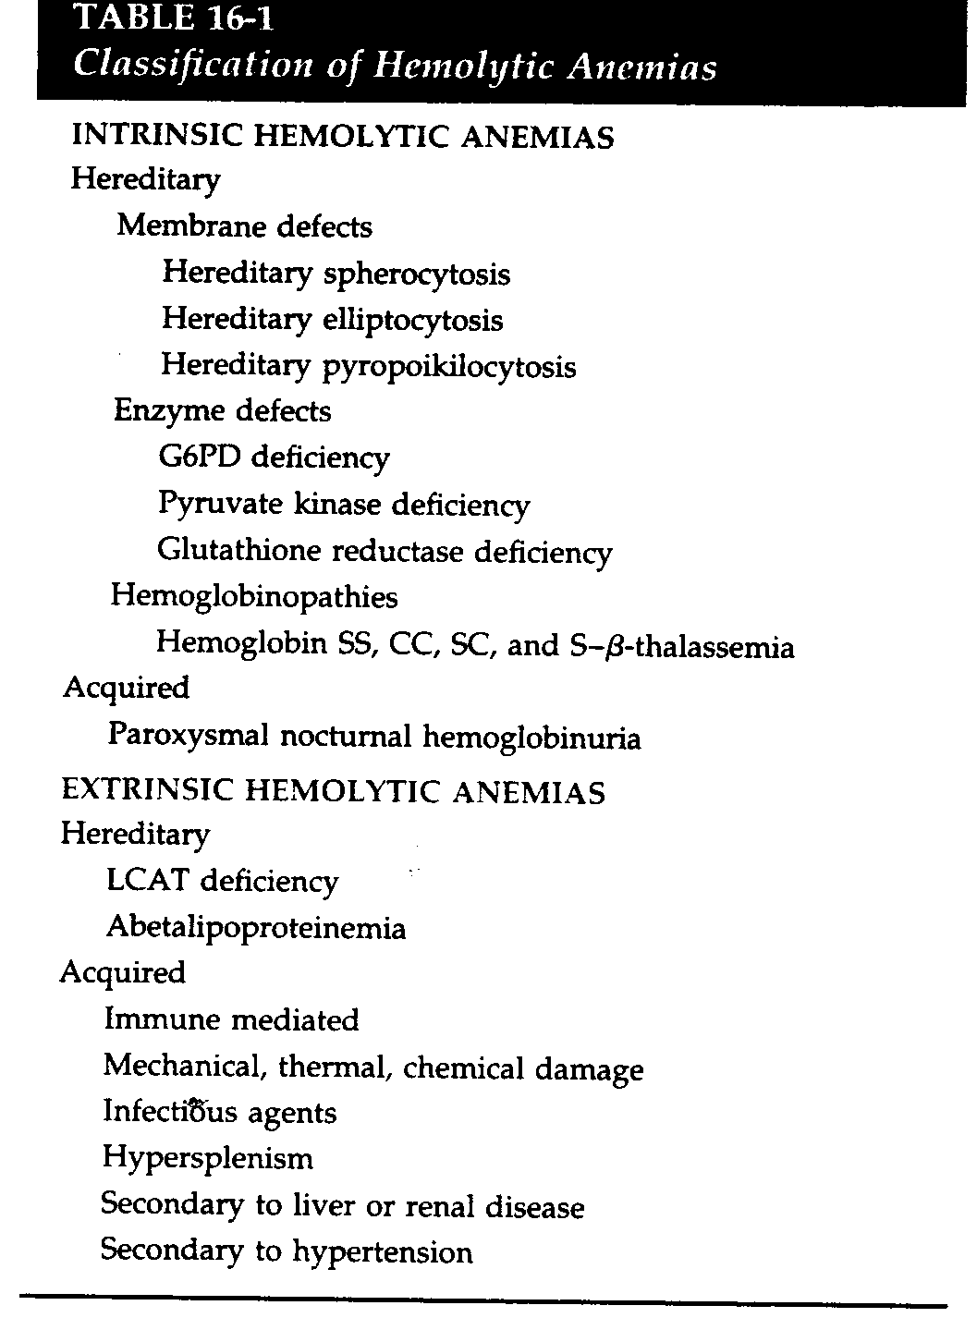

Slide 6
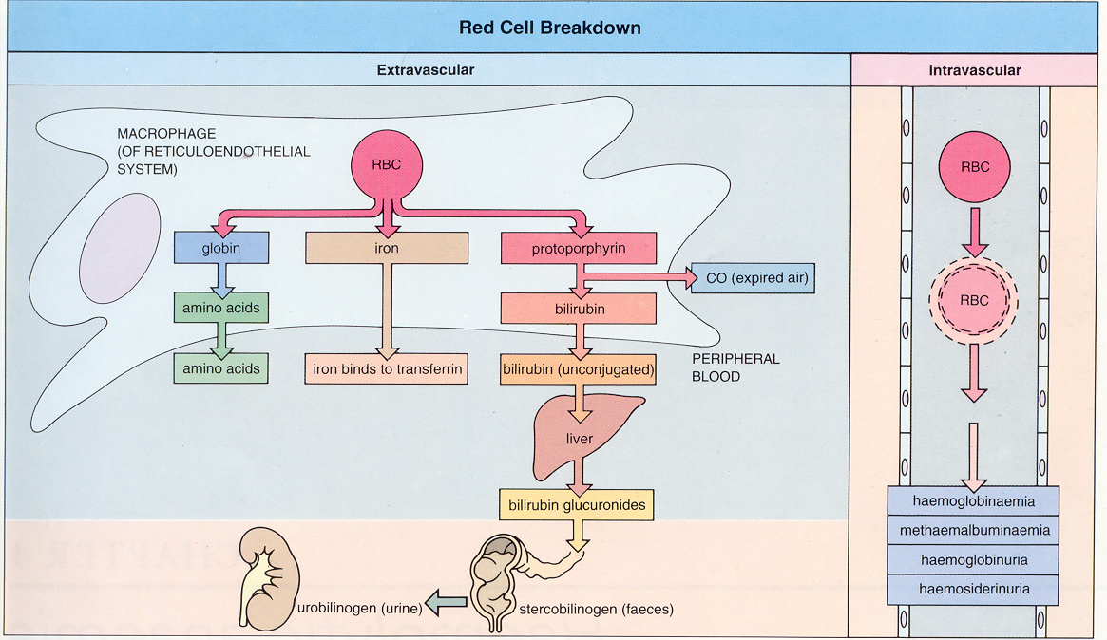

Slide 7
Laboratory signs of hemolysis
↓ Haptoglobin ↑ Lactate dehydrogenase (LDH):
↑ Indirect/unconjugated bilirubin
↑ Reticulocytes:
In extreme hemolysis: ↑ free hemoglobin
Brown-colored urine due to hemoglobinuria
Notes:
↓ Haptoglobin Only free and unbound haptoglobin is measured Hemoglobin released from broken down erythrocytes binds to haptoglobin; . → ↓ free, circulating haptoglobin Occurs mostly in intravascular hemolysis Haptoglobin can be increased or normal as a reaction to an infectious process, thereby masking hemolysis
↑ Lactate dehydrogenase (LDH): nonspecific parameter that simply indicates increased cellular breakdown ↑ Indirect/unconjugated bilirubin
Hemoglobin released from erythrocytes is turned into indirect/unconjugated bilirubin. Increased bilirubin levels can result in icterus. Urobilinogenuria
↑ Reticulocytes: loss of erythrocytes → reactive increase in erythropoiesis → increase in reticulocytes in the peripheral blood In extreme hemolysis: ↑ free hemoglobin
Brown-colored urine due to hemoglobinuria

Slide 8
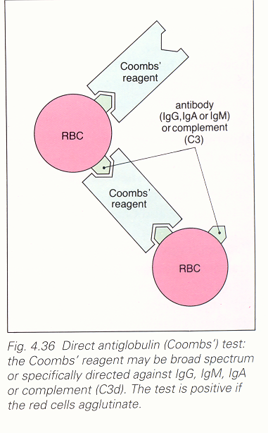

This test detects antibodies and/or complement proteins on RBCs surface; (direct test) or in patient's serum (indirect test).
The test uses a special Coombs serum that contains anti-human globulins.
A positive result in a patient with hemolysis supports the diagnosis of antibody-mediated, extracorpuscular anemia.

Slide 9
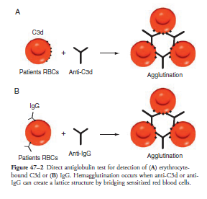
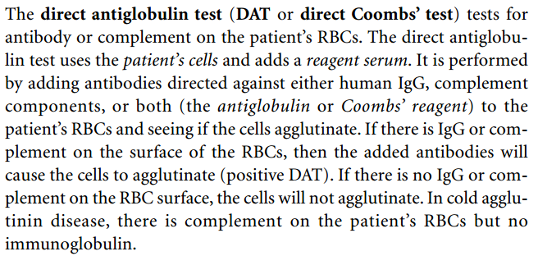
Notes:
Direct Coombs test After taking a patient's blood sample, it is purified so that only the erythrocytes remain. Coombs serum containing anti-human globulins (antigens) is added. The examiner visually analyzes the sample and looks for erythrocyte agglutination.
In the case of erythrocyte agglutination → positive test → confirmation of preexisting erythrocytes coated with autoantibodies In the case of absent erythrocyte agglutination → negative test

Slide 10
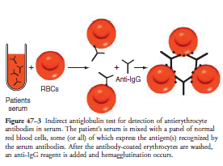
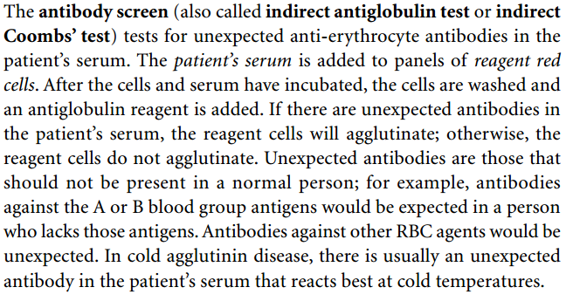
Notes:
Indirect Coombs test After taking a patient's blood sample, it is purified so that only the serum remains. A donor's blood sample containing erythrocytes is added. Coombs serum containing anti-human globulins (antigens) is added as well. The examiner visually analyzes the sample and looks for erythrocyte agglutination.
In the case of erythrocyte agglutination → positive test → confirmation of preexisting circulating, free antibodies within patient's serum that bound to donor's RBC surfaces In the case of absent erythrocyte agglutination → negative test

Slide 11
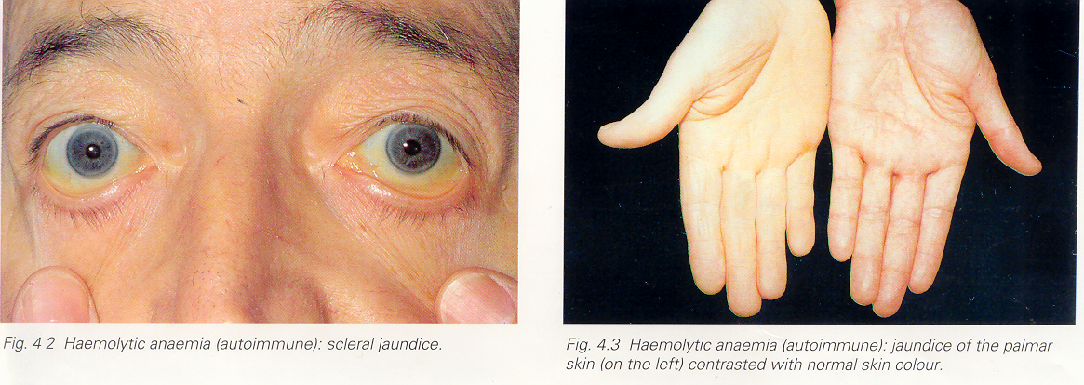

Slide 12
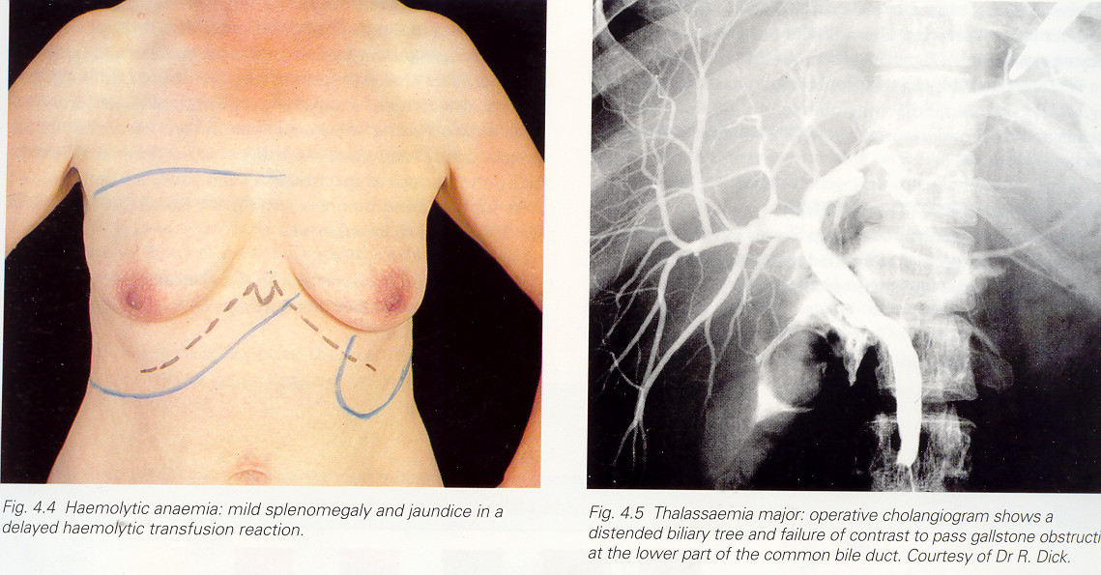
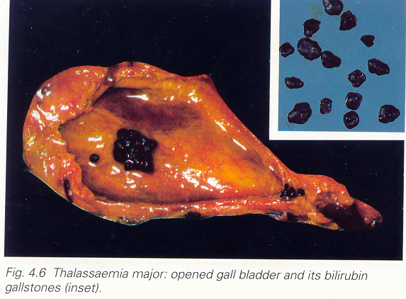

Slide 13
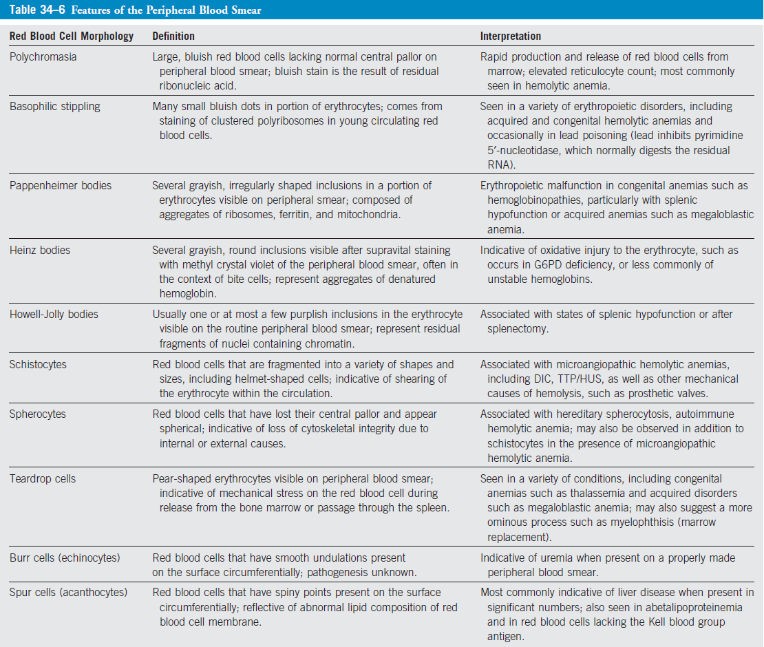

Slide 14
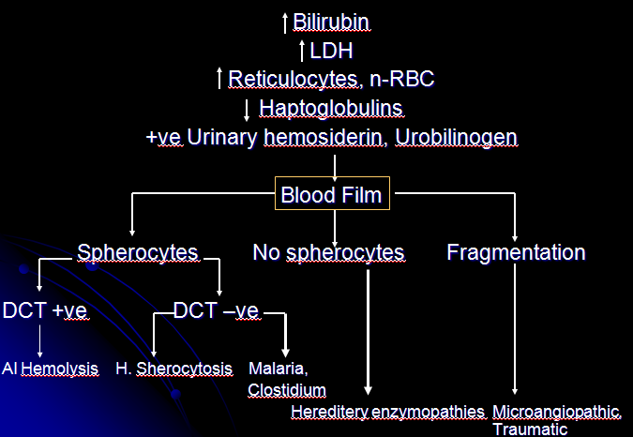

Slide 15
Autoimmune Hemolytic Anemia
Result from RBC destruction due to RBC autoantibodies: Ig G, M, E, A
Most commonly-idiopathic
Classification
Warm AI hemolysis: Ab binds at 37 degree Celsius
Cold AI Hemolysis: Ab binds at 4 degree Celsius

Slide 16
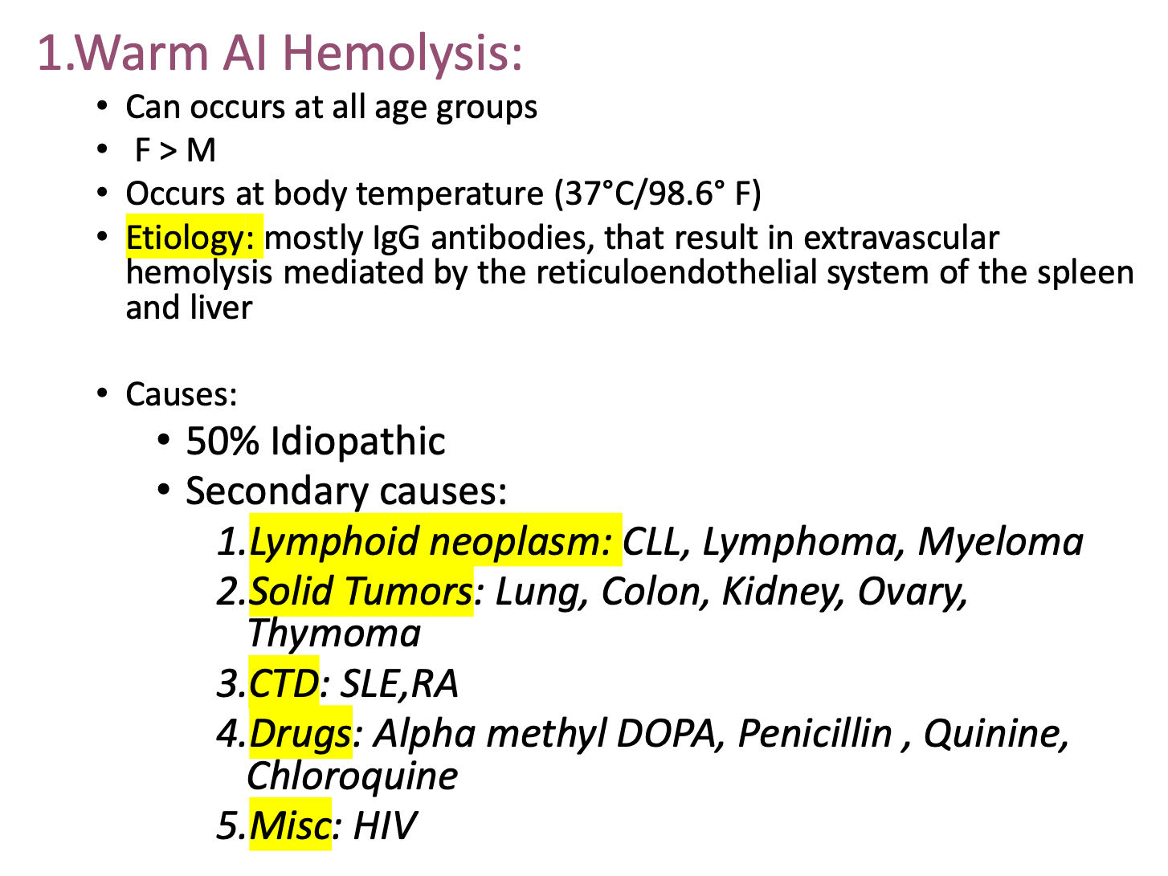

Slide 17
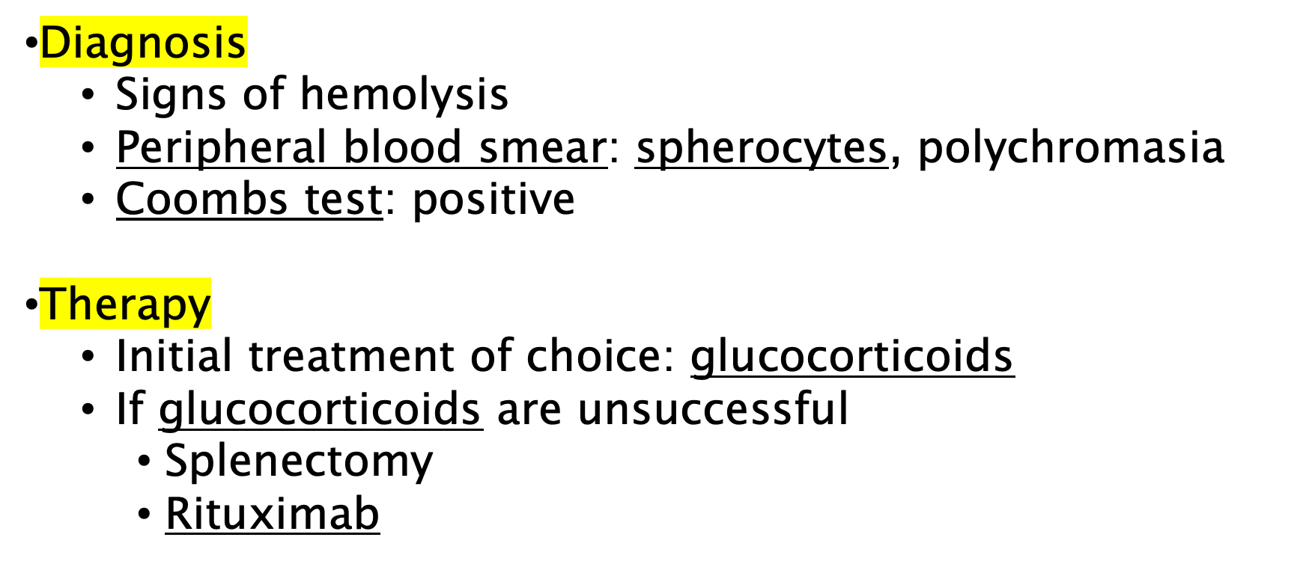

Slide 18
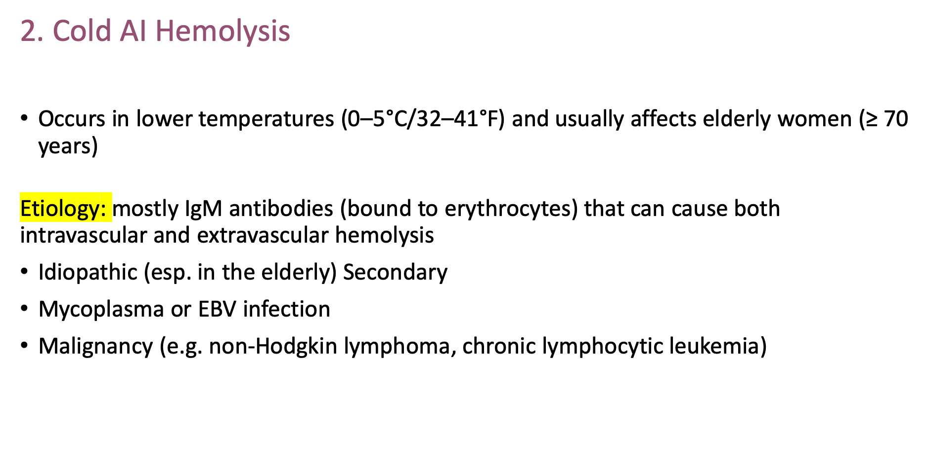

Slide 19
Cold Agglutinin Disease (CAD): What it is
Definition: Complement-mediated hemolytic anemia caused by cold-reactive IgM antibodies
Primary CAD vs Secondary Cold Agglutinin Syndrome (CAS)
Primary: clonal B-cell disorder / “primary” CAD
Secondary: infections (e.g., Mycoplasma pneumoniae, EBV) or lymphoproliferative disease
Key concept: Hemolysis is mainly extravascular (C3b-mediated), can have intravascular component in severe cases

Slide 20
Pathophysiology: Thermal amplitude + complement
IgM binds RBCs in cooler peripheral circulation → agglutination
IgM fixes complement (C1 → C4/C2 → C3)
In liver: macrophages clear C3b-opsonized RBCs
Thermal amplitude (how warm the antibody remains active) predicts clinical severity

Slide 21
Clinical features
Hemolytic anemia symptoms: fatigue, dyspnea, jaundice
Cold-induced symptoms: acrocyanosis, Raynaud-like changes, livedo, pain/numbness
Hemoglobinuria can occur in severe complement activation
Triggers: cold exposure, infections, surgery, transfusion without warming

Slide 22
Diagnosis: What to order / what to look for
DAT (Direct antiglobulin test): typically C3d positive, IgG negative
Cold agglutinin titer and/or thermal amplitude assessment
Hemolysis labs: ↑LDH, ↑indirect bilirubin, ↓haptoglobin, ↑reticulocytes
Peripheral smear: RBC agglutination may be seen
Lab artifacts: spuriously ↑MCV, ↓RBC count, abnormal CBC unless sample warmed

Slide 23
Management: practical and modern
First-line supportive: strict cold avoidance, warm clothing, treat triggers
Transfusion: warm patient + use blood warmer, warm IV fluids
Pharmacologic options
Rituximab-based therapy (± bendamustine) for clonal disease
Complement inhibition (classical pathway): sutimlimab can rapidly improve hemolysis (where available)
Steroids/splenectomy: generally ineffective in CAD (unlike warm AIHA)

Slide 24
Warm AIHA vs CAD
Warm: IgG, splenic clearance, DAT IgG+
CAD: IgM→complement, hepatic clearance, DAT C3d+
Steroids: warm often responds; CAD usually not
Key complication: cold-induced circulatory symptoms in CAD

Slide 25
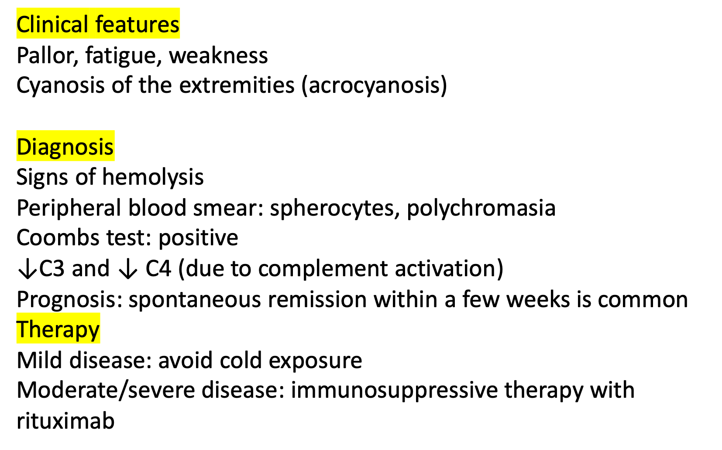

Slide 26
Microangiopathic hemolytic anemia
Hemolytic uremic syndrome (HUS)
Thrombotic thrombocytopenic purpura (TTP)
Malignant hypertension
Systemic lupus erythematosus (SLE)
HELLP Syndrome
DIC
Notes:
Macroangiopathic hemolytic anemia
Etiology
Moderate and severe aortic stenosis: heart valve replacement resolves the anemia
Prosthetic heart valve
Extracorporeal circulation (e.g., dialysis)
Exertional hemoglobinuria (“March hemoglobinuria”): destruction of RBCs in the feet during strenuous exercise (especially running and walking on hard surfaces)
Pathophysiology
RBC destruction in the systemic circulation due to mechanical forces applied to the erythrocyte membrane
Clinical features
Features of anemia (e.g., pallor, fatigue)
Features of intravascular hemolysis

Slide 27
Paroxysmal nocturnal hemoglobinuria
Paroxysmal nocturnal hemoglobinuria is an acquired genetic disorder that results in increased susceptibility of RBCs to lysis by the complement system.
The condition results from an inability to synthesize the glycosyl phosphatidylinositol (GPI) anchor, which anchors a variety of molecules on the surface of erythrocytes and other cells.
Among the molecules that use the GPI anchor are the membrane inhibitor of reactive lysis (MIRL; CD59 in the Cluster Designation system for leukocyte antigens), decay accelerating factor (DAF; CD55), and the homologous restriction factor (C8 binding protein), which are all involved in the RBC defense against complement
Result : Intravascular Hemolysis

Slide 28
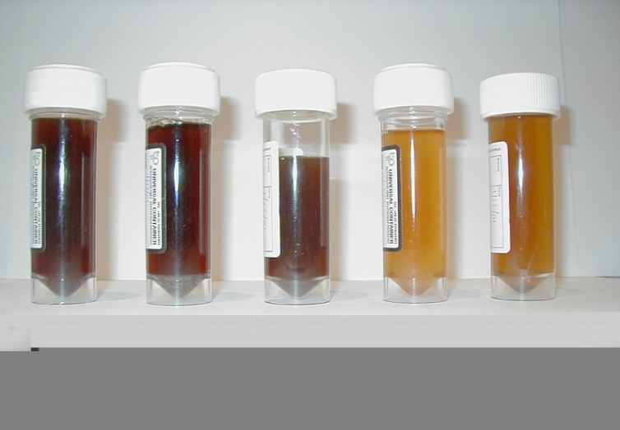
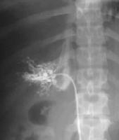
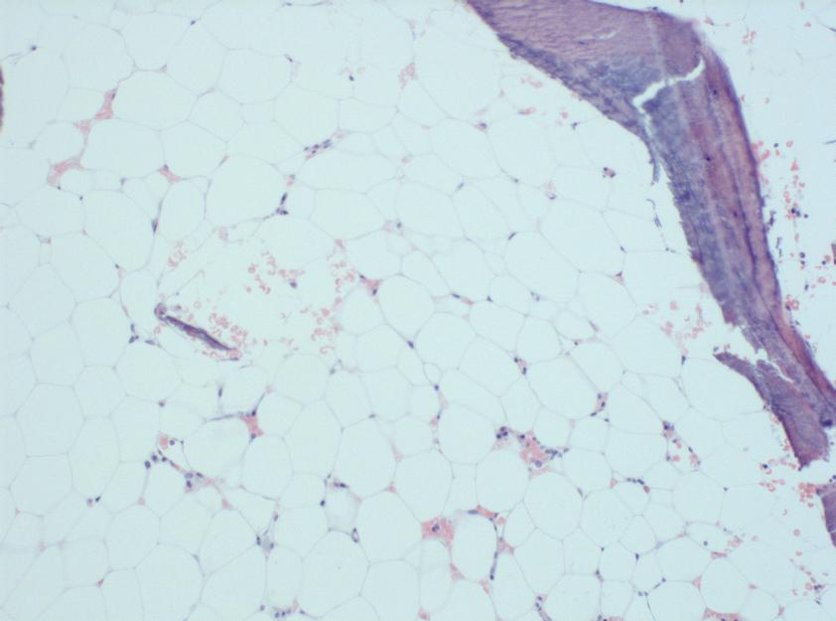
PNH – Triad of Clinical Features
Haemoglobinuria
Budd-Chiari
syndrome
Aplastic anaemia
Intravascular haemolysis
🡪 disabling symptoms
abdominal pain
dysphagia
erectile failure
severe lethargy
Thrombosis
- liver, cerebral
- 50% of patients
- 33% of patients is fatal
Bone Marrow Failure
often precedes PNH
selects for PNH clone

Slide 29








PNH is a Progressive Disease of Chronic Haemolysis ⁽¹⁻⁴⁾
Normal red blood cells are protected from complement attack by a shield of terminal complement inhibitors ^{(2,3)}
Without this protective complement inhibitor shield, PNH red blood cells are destroyed ^{(2,3)}
Thrombosis
Renal Failure
Significant Impact on Survival ⁽³⁾
Pulmonary Hypertension
Complement Activation
Abdominal Pain
Dyspnoea
Intact RBC
Fatigue
Significant Impact on Morbidity ⁽³⁾
Free Haemoglobin in the Blood from Destroyed PNH RBCs
Dysphagia
Haemoglobinuria
Anaemia
Erectile Dysfunction
(1) Rother R et al. JAMA 2005;293:1653-1662; (2) Brodsky RA. Blood Rev 2008;22:65-74;
(3) Rother R et al. Nat Biotech 2007;25:1256-1264; (4) Socie G et al. Lancet 1996;348:573-577.
Notes:
The phosphatidylinositol glycan-complementation class A (PIG-A) gene encodes a subunit of N-acetyl glucosamine phosphatidylinositol transferase, a protein essential for the synthesis of glycosylphosphotidylinositol (GPI), a lipid moiety that serves to anchor a variety of proteins to the cell surface
Because the mutation in the PIG-A gene takes place in a pluripotent hematopoietic stem cell, the mutation results in a deficiency of GPI-anchored proteins in all blood cell types
Lack of GPI-anchored proteins results in absence of complement inhibitors leading to hemolysis in PNH
Parker, et al. Blood. 2005;106:3699-3709.

Slide 30
WHAT IS FLAER? FLuorescent AERolysin
Aerolysin is a pore-forming toxin secreted by Aeromonas hydrophila - GPI-anchor serves as receptor
FLAER – A488-conjugated mutant aerolysin binds to GPI -anchor rather than surrogate protein and is inactive so doesn’t form channels
α-CD59

Slide 31
Who Should be Tested for PNH?
• Patients with unexplained hemolytic anemia
• Patients with bone marrow failure, including aplastic anemia and MDS
• Patients with hemoglobinuria
• Patients with unusual/repetitive thrombosis, and arterial thrombosis otherwise unexplained.
• Patients with episodic swallowing problems or abdominal pain of unclear etiology with associated hemolysis

Slide 32
Eculizumab
• First/only drug targeted to PNH
• Monoclonal antibody against complement protein 5 (C5). Binds this protein and halts the rest of the complement cascade.
• “Protects” PNH cells from destruction by halting the complement cascade.
• Very effective at reducing hemolysis, reducing transfusion needs, improving QOL. Early evidence suggests it may reduce clots.

Slide 33
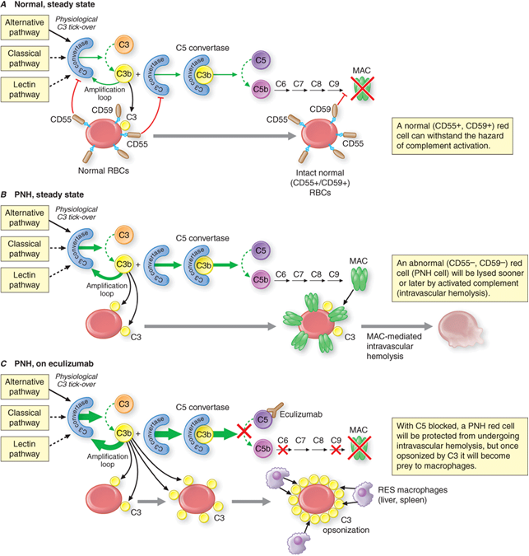
The most common defective enzyme in PNH is phosphatidylinositol glycan A (PIGA), one of several enzymes needed to make GPI.
İntrinsic defect in
the cell membrane
(deficiency of glycophosphatidylinositol leading to absence of protective proteins on the membrane)

Slide 34
SUMMARY
Hemolytic anemias are a group of conditions characterized by the breakdown of red blood cells.
Hemolysis is caused by either abnormalities of the RBCs themselves (abnormalities in hemoglobin, the RBC membrane or intracellular enzymes), also called corpuscular anemia, or by external causes (immune-mediated or mechanical damage), which is referred to as extracorpuscular anemia.
All hemolytic anemias feature varying degrees of fatigue, pallor, and weakness (from asymptomatic disease to life-threatening hemolytic crisis), although some diseases have more specific findings (e.g., venous thrombosis in paroxysmal nocturnal hemoglobinuria).
Notes:
Hemolytic anemias are a group of conditions characterized by the breakdown of red blood cells. Hemolysis is caused by either abnormalities of the RBCs themselves (abnormalities in hemoglobin, the RBC membrane or intracellular enzymes), also called corpuscular anemia, or by external causes (immune-mediated or mechanical damage), which is referred to as extracorpuscular anemia. All hemolytic anemias feature varying degrees of fatigue, pallor, and weakness (from asymptomatic disease to life-threatening hemolytic crisis), although some diseases have more specific findings (e.g., venous thrombosis in paroxysmal nocturnal hemoglobinuria). They also share common laboratory findings, such as elevated indirect bilirubin and lactate dehydrogenase, reticulocytosis, and decreased haptoglobin levels. The Coombs test helps to distinguish autoimmune (positive Coombs test) from non- autoimmune anemias (negative Coombs test). Treatment includes RBC transfusions as required but otherwise depends on the specific type of hemolytic anemia and its causes.

Slide 35
They also share common laboratory findings, such as elevated indirect bilirubin and lactate dehydrogenase, reticulocytosis, and decreased haptoglobin levels.
The Coombs test helps to distinguish autoimmune (positive Coombs test) from non- autoimmune anemias (negative Coombs test).
Treatment includes RBC transfusions as required but otherwise depends on the specific type of hemolytic anemia and its causes.

