Slide 1
DIC
Dr.Engin KELKİTLİ

Slide 2
Disseminated intravascular coagulation (DIC) also called
consumption coagulopathy and
defibrination syndrome
is a systemic process with the potential for causing thrombosis and hemorrhage.

Slide 3
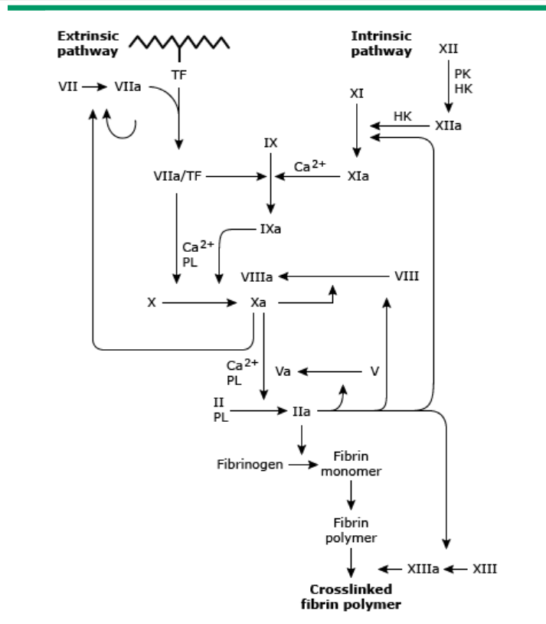
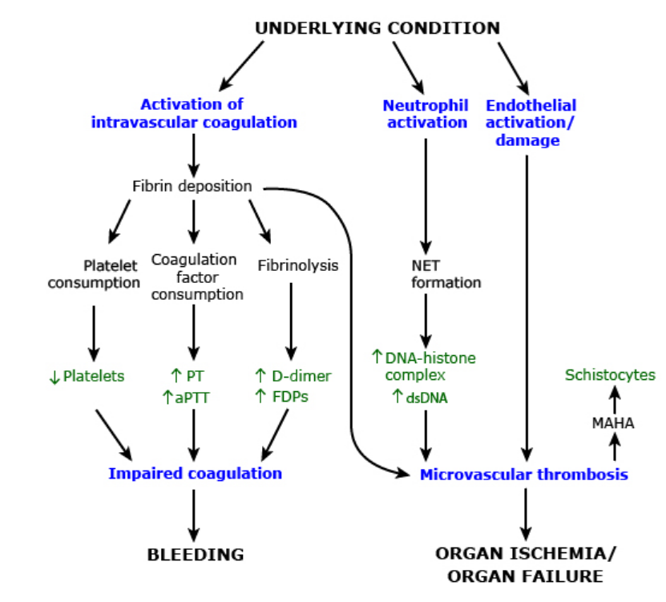
Normal hemostasis ensures formation of a blood clot at the site of vessel injury, followed by resolution of the clot to allow tissue repair.
I. Activation of Fibrinolysis
II. Suppression of natural anticoagulation
III. Increased thrombin formation
IV. Activation of the inflammatory system
Notes:
In DIC, the processes of coagulation and fibrinolysis become abnormally (and often massively) activated, leading to ongoing coagulation and fibrinolysis.
A typical sequence of events includes as you see

Slide 4
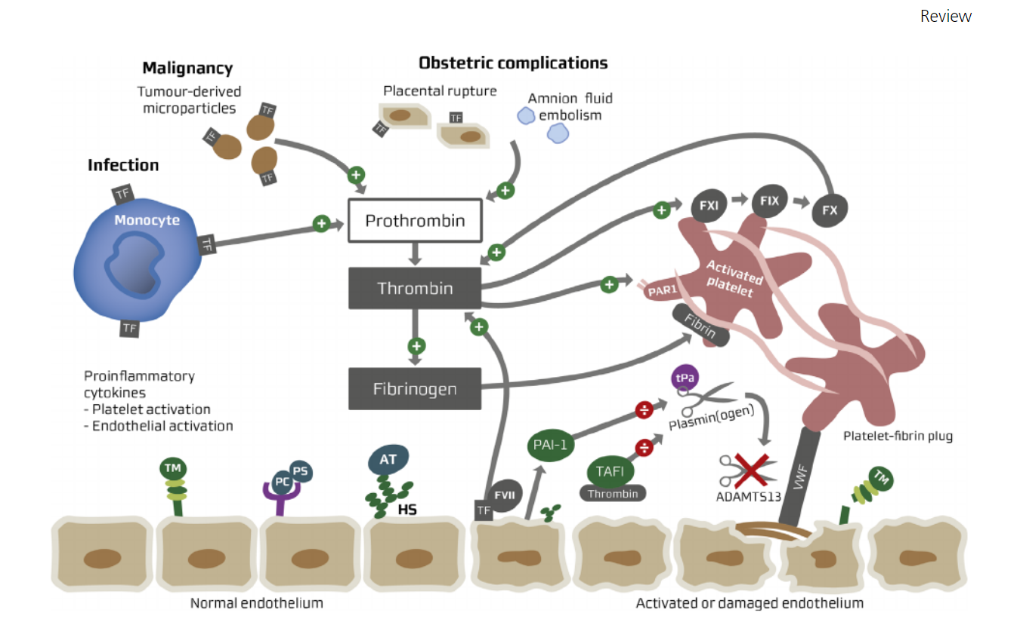

Slide 5
Procoagulant exposure
Blood is exposed to one or more procoagulants, such as tissue factor (TF), from which it is normally protected. Sources and components of these procoagulants depend on the underlying condition.
Some bacterial products, such as lipopolysaccharides, can activate coagulation .
In trauma, damage to the vascular endothelium and tissues may cause release of procoagulant enzymes or phospholipids.
In meningococcal sepsis, microparticles containing TF are found in the circulation
Neutrophils may contribute to the formation of neutrophil extracellular traps (NETs), which have procoagulant properties.
Cancer procoagulant" generally refers to TF produced by cancer cells. It can also be a proteolytic enzyme produced by some mucinous tumors and placenta that is capable of activating factor X.
Notes:
As examples:

Slide 6
Disseminated intravascular coagulation (DIC) is a paradox in the hemostatic sequence characterized by widespread coagulation and bleeding.
It is not a primary disease but a complication of many different disorders.
Disseminated intravascular coagulation begins with massive activation of the coagulation sequence, which leads to fibrin deposition and formation of thrombin in the microcirculation of the body.
The widespread deposition of fibrin leads to tissue ischemia and hemolytic anemia from fragmentation of red cells as they squeeze through the narrowed microvasculature.

Slide 7
As a consequence of the thrombotic process, there is consumption of platelets and coagulation factors and the activation of plasminogen that leads to a hemorrhagic diathesis.

Slide 8
The disorder can be initiated by activation of the intrinsic or extrinsic pathway, or both.
Activation through the extrinsic pathway occurs with liberation of tissue factors and is associated with obstetric complications, trauma, bacterial sepsis, and cancer.
The intrinsic pathway may be activated through extensive endothelial damage, with activation of factor XII. Endothelial damage may be caused by viruses, infections, immune mechanisms, stasis of blood, or temperature extremes.
Impaired anticoagulation pathways are also associated with reduced levels of antithrombin and the protein C anticoagulant system in DIC. T

Slide 9
There is increasing evidence that the underlying cause of DIC is infection or inflammation, and the cytokines (tumor necrosis factor, interleukin-1, and IL6) liberated in the process are the pivotal mediators.
These cytokines not only mediate in inflammation, but can also increase the expression of tissue factor on endothelial cells and simultaneously decrease the expression of thrombomodulin.
Thrombomodulin is a glycoprotein, present on the cell membrane of endothelial cells, that binds thrombin (IIa) and acts as an additional regulatory mechanism in coagulation.
The net effect is a shift in balance toward a procoagulant state.

Slide 10
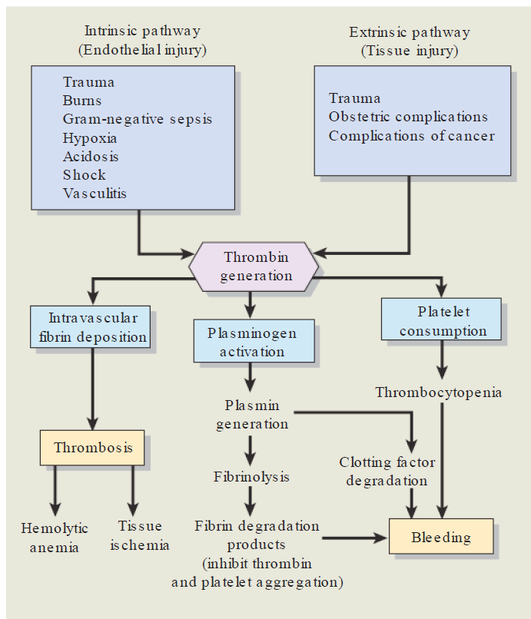

Slide 11
Common clinical conditions that may cause DIC include obstetric disorders, accounting for 50% of cases; massive trauma; shock; sepsis; and malignant disease.
In obstetric complications, tissue factors released from necrotic placental or fetal tissue or amniotic fluid may enter the circulation, inciting DIC.
The hypoxia, shock, and acidosis that may coexist also contribute by causing endothelial injury.
Gram-negative bacterial infections result in the release of endotoxins, which activate both the extrinsic pathway by release of tissue factor and the intrinsic pathway through endothelial damage. Endotoxins also inhibit the activity of protein C.
Antigen–antibody complexes associated with infection can activate platelets through complement fragments.

Slide 12
Although coagulation and formation of microemboli characterize DIC, its acute manifestations usually are more directly related to the bleeding problems that occur.
The bleeding may be present as petechiae, purpura, oozing from puncture sites, or severe hemorrhage.
Uncontrolled postpartum bleeding may indicate DIC.
Microemboli may obstruct blood vessels and cause tissue hypoxia and necrotic damage to organ structures, such as the kidneys, heart, lungs, and brain.
As a result, common clinical signs may be due to renal, circulatory, or respiratory failure; acute bleeding ulcers; or convulsions and coma.
A form of hemolytic anemia may develop as red cells are damaged passing through vessels partially blocked by thrombus.

Slide 13
