Slide 1

CLASSİFİCATİON OF ANEMİA 04/02/2021

Slide 2

What İs Anemia?
Anemia is defined as a decrease in the quantity of circulating red blood cells (RBC), represented by a reduction in hemoglobin concentration (Hb), hematocrit (Hct ), or RBC count.
.

Slide 3
Definition
Definition: a decrease in the absolute number of circulating RBCs; exact cutoffs vary from source to source.
WHO criteria for anemia.
Men: Hb < 13 g/dL
Women: Hb < 12 g/dL

Slide 4
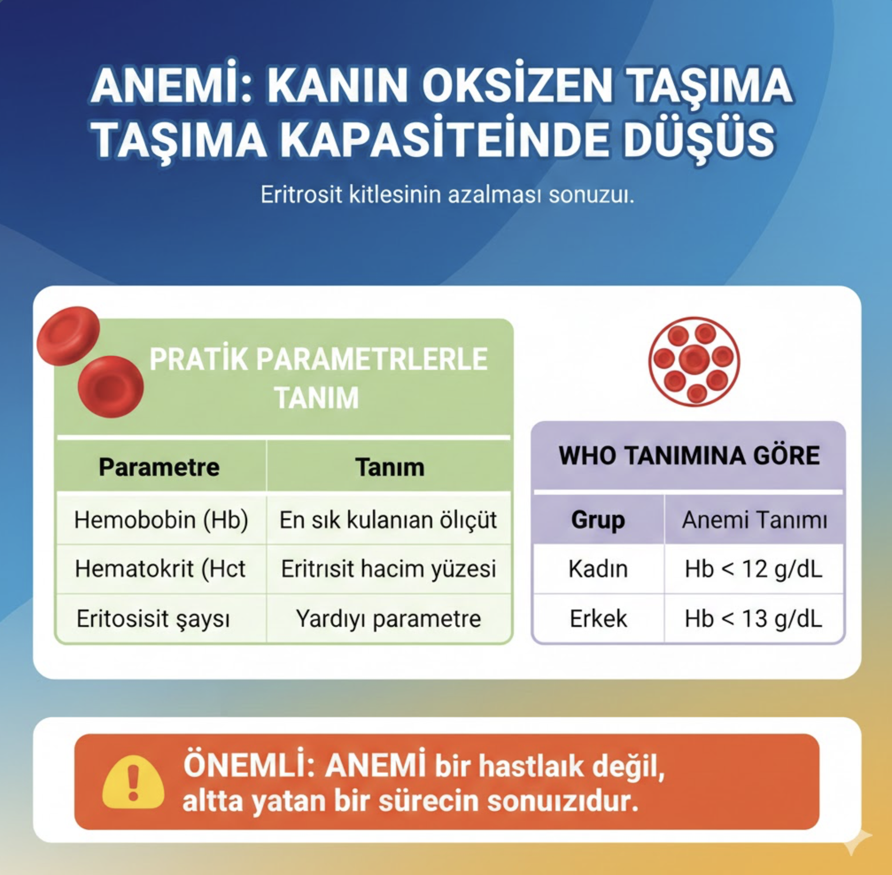

Slide 5
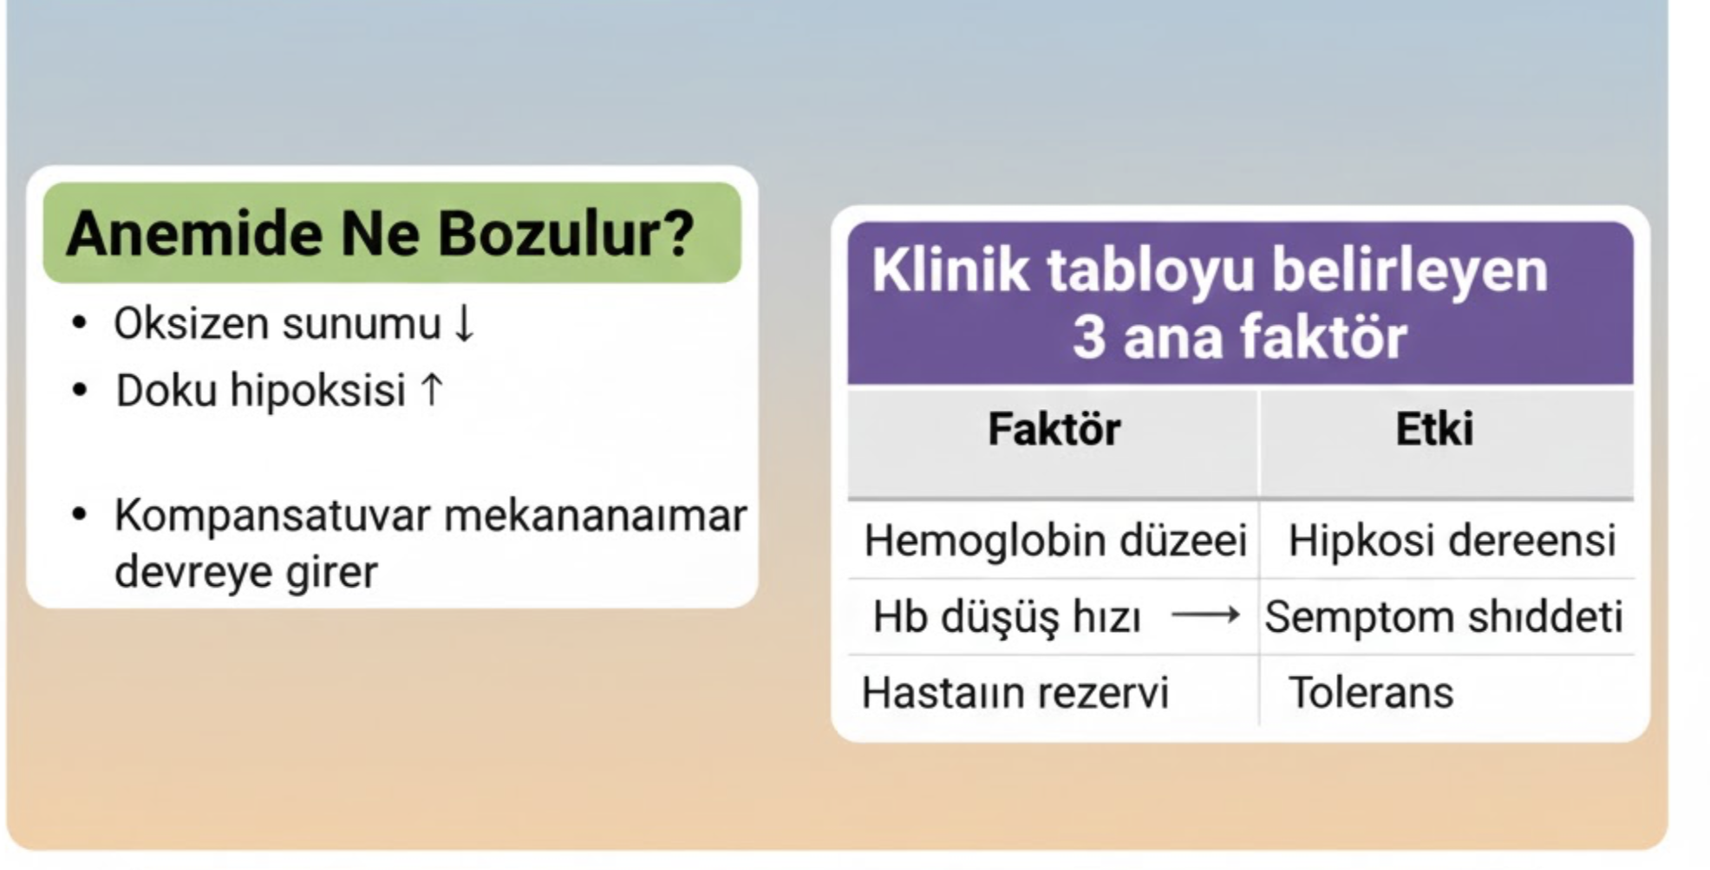

Slide 6
When evaluating anemia, we ask three fundamental questions:
RBC Production ──► Is the bone marrow functioning?
RBC Destruction ──► Is there hemolysis?
RBC Loss ──► Is there active bleeding?
Classification of Anemias: Anemias are classified based on:
Cell Size (Morphological: Microcytic, Normocytic, Macrocytic)
Bone Marrow Response (Regenerative vs. Non-regenerative)
Pathophysiological Mechanism (Blood loss, Hemolysis, Decreased production)

Slide 7
Classification
Morphology/size of RBCs (the classification most widely used)
Time course: acute vs. chronic
Inheritance: inherited vs. acquired
Etiology: primary vs. secondary
RBC proliferation: hypoproliferative (decreased RBC production) vs. hyperproliferative (increased RBC destruction or blood loss)
Notes:
Anemia may be classified into several subtypes based on the following methods:

Slide 8


Reticulocyte = Young RBC
Anemia due to hemolysis or bleeding is characterized by the presence of a reticulocytosis.
The reticulocyte count is used to assess the appropriateness of the bone marrow response to anemia.
The normal reticulocyte count in a patient with a normal Hb and Hct is about 1%.
Approximately 1% of circulating RBCs are removed daily and replaced by marrow young RBCs or reticulocytes (approximately 20 cc of RBCs /day).

Slide 9
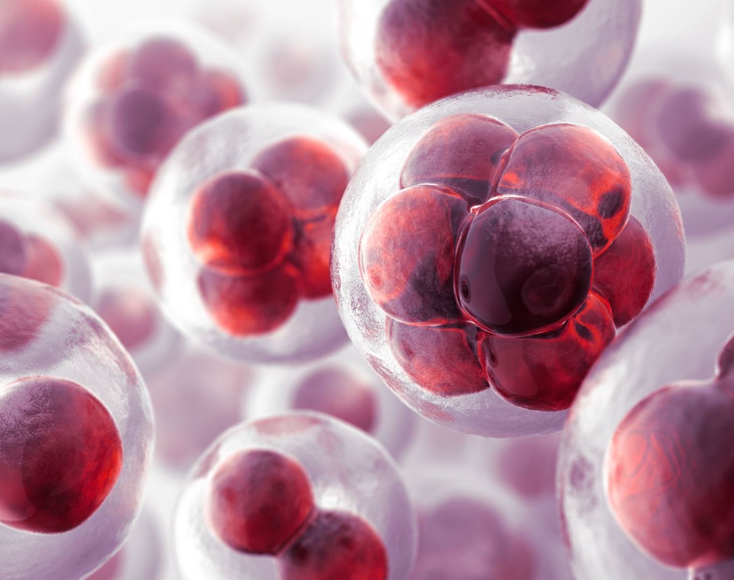
Mean Cell (or Corpuscular) Volume (MCV):
The MCV reflects the average size or volume of the RBC expressed in fl.
MCV will tell you if the patient is micro, macro, or normocytic .

Slide 10
Mean Cell Hemoglobin (MCH):
The MCH indicates the weight of Hb in the average red cell.
Mean Cell Hemoglobin Concentration (MCHC):
The MCHC indicates the concentration of Hb in the average red cell or the ratio of the weight of the Hb to the volume in which it is contained (chromicity)

Slide 11
Normal red blood cell morphology:
Characterized by a donut shape with the center 1/3 of the red cell being pale or without hemoglobin.
This is assessed on peripheral smear.

Slide 12

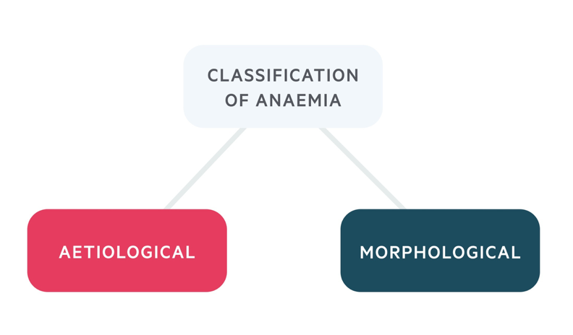
Classification
Causes of anaemia can be classified based upon aetiology or morphology.

Slide 13
Classification of anemia by morphology
The morphological approach categorises anaemia based on the size of RBCs (e.g. the mean corpuscular volume).
Microcytic (small RBCs)
Normocytic (normal sized RBCs)
Macrocytic (large RBCs)
This approach arranges anaemia into three groups:

Slide 14
Microcytic
Anaemia is described as microcytic when the MCV is < 80 fL.
Microcytic anaemia is commonly associated with a reduction in the mean corpuscular haemoglobin concentration (MCHC), which leads to the appearance of pale (hypochromic) RBCs.
The most common cause of microcytic anaemia is iron-deficiency anaemia (IDA). This may be evaluated with iron studies (transferrin and serum iron) and serum ferritin.
Other important causes of microcytic anaemia include:
Anaemia of chronic disease (predominantly causes normocytic anaemia)
Thalassaemia
Other haemoglobinopathies
Lead poisoning
Sideroblastic anaemia

Slide 15
Normocytic
Anaemia is described as normocytic when the MCV is within normal limits (80-100 fL).
The causes of normocytic anaemia are extremely broad and it may reflect the early stages of either a microcytic or macrocytic anaemia.
Anaemia may be the first manifestation of a systemic disorder. One of the most common causes of a normocytic anaemia is ‘anaemia of chronic disease’.
Other common causes of a normocytic anaemia include blood loss, renal disease, cancer-associated anaemia and pregnancy.

Slide 16
Macrocytic
Anaemia is described as macrocytic when the MCV is > 99 fL.
There are numerous causes of a macrocytic anaemia, but it is commonly secondary to folate and/or B₁₂deficiency. Folate and B₁₂ deficiency cause a megaloblastic (immature) macrocytic anaemia and abnormal nucleic acid metabolism.
Drugs that interfere with nucleic acid metabolism may also cause a macrocytic anaemia (e.g. methotrexate).
Other important causes of a macrocytic anaemia include:
Alcohol abuse
Liver disease
Hypothyroidism
Haematological malignancies
Reticulocytosis

Slide 17
Aetiological
The aetiological approach addresses the underlying mechanism leading to the reduction in Hb concentration.
Aetiologically, causes can be arranged into three groups:
Decreased RBC production
Increased RBC destruction
Blood loss

Slide 18
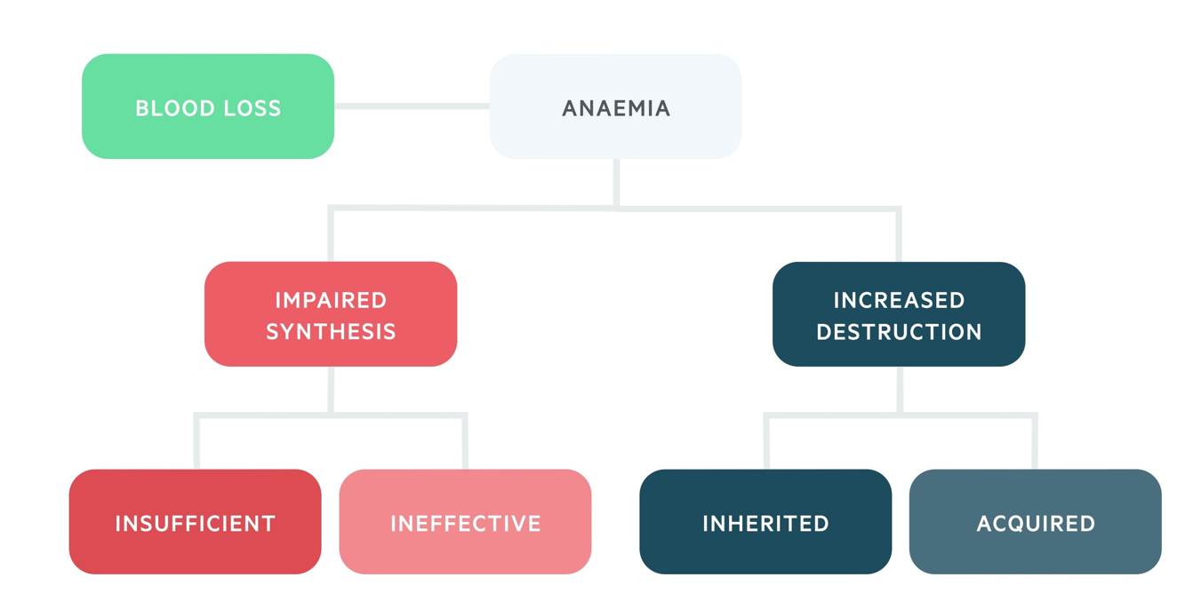
Aetiological classification
Classifies the causes of anaemia based upon the underlying mechanisms.

Slide 19
Insufficient production
Anaemia will develop if the rate of RBC production does not adequately meet the bodies requirements.
A decrease in RBC production can occur due to two main mechanisms:
Insufficient production of RBCs
Ineffective production of RBCs
Insufficient production of RBCs occurs when the normal erythropoietic process is reduced or inhibited. This may be due to a lack of required nutrients (e.g. iron), reduced hormonal influence (e.g. low EPO, hypothyroid), bone marrow suppression or bone marrow infiltration.

Slide 20
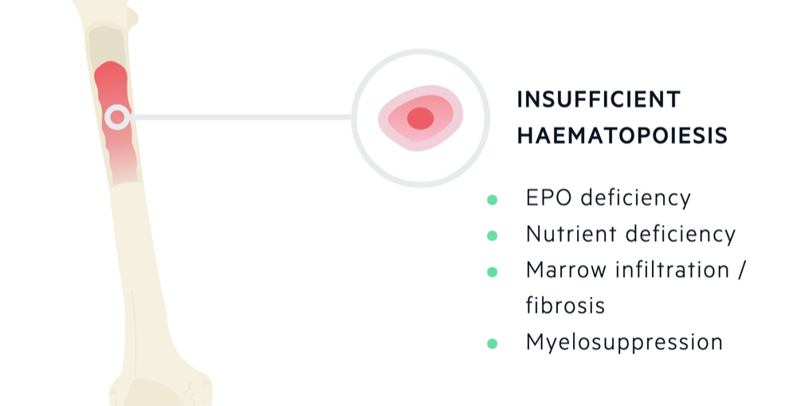

Slide 21
Ineffective production
Ineffective production of RBCs occurs due to abnormal erythropoiesis.
There is a marked increase in the erythroid cell line in the bone marrow, but erythroid precursors do not mature properly and subsequently undergo apoptosis.
Conditions that lead to ineffective erythropoiesis include megaloblastic anaemias (e.g. folate and B12 deficiency), thalassaemias, myelodysplastic syndromes and sideroblastic anaemia.

Slide 22
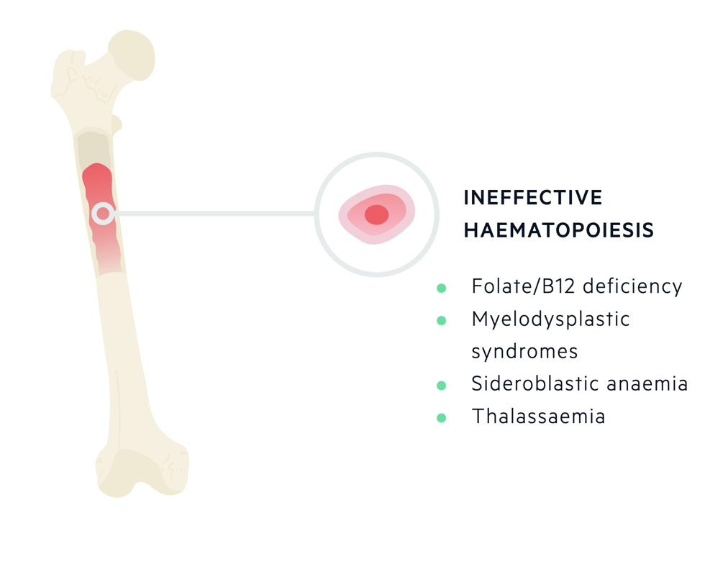

Slide 23
Increased destruction
Haemolysis refers to the destruction of red blood cells, which is broadly defined as a reduction in the lifespan of RBCs below 100 days (normal 110-120 days).
If RBC production in the bone marrow cannot keep pace with the level of haemolysis, then haemolytic anaemia with ensue. The haemolytic anaemias can be divided into inherited and acquired.
Inherited haemolytic anaemias can be further classified based on the site of inherited defect:
Membrane abnormalities (e.g. hereditary spherocytosis)
Metabolic deficiencies (e.g. G6PD deficiency)
Haemoglobin abnormalities (e.g. alpha-thalassaemia, beta-thalassaemia, sickle cell disease)

Slide 24
Acquired haemolytic anaemias can be divided into immune and non-immune:
Immune (e.g. warm and cold autoimmune haemolytic anaemia)
Non-immune (e.g. mechanical trauma, hypersplenism, infections, drugs)

Slide 25
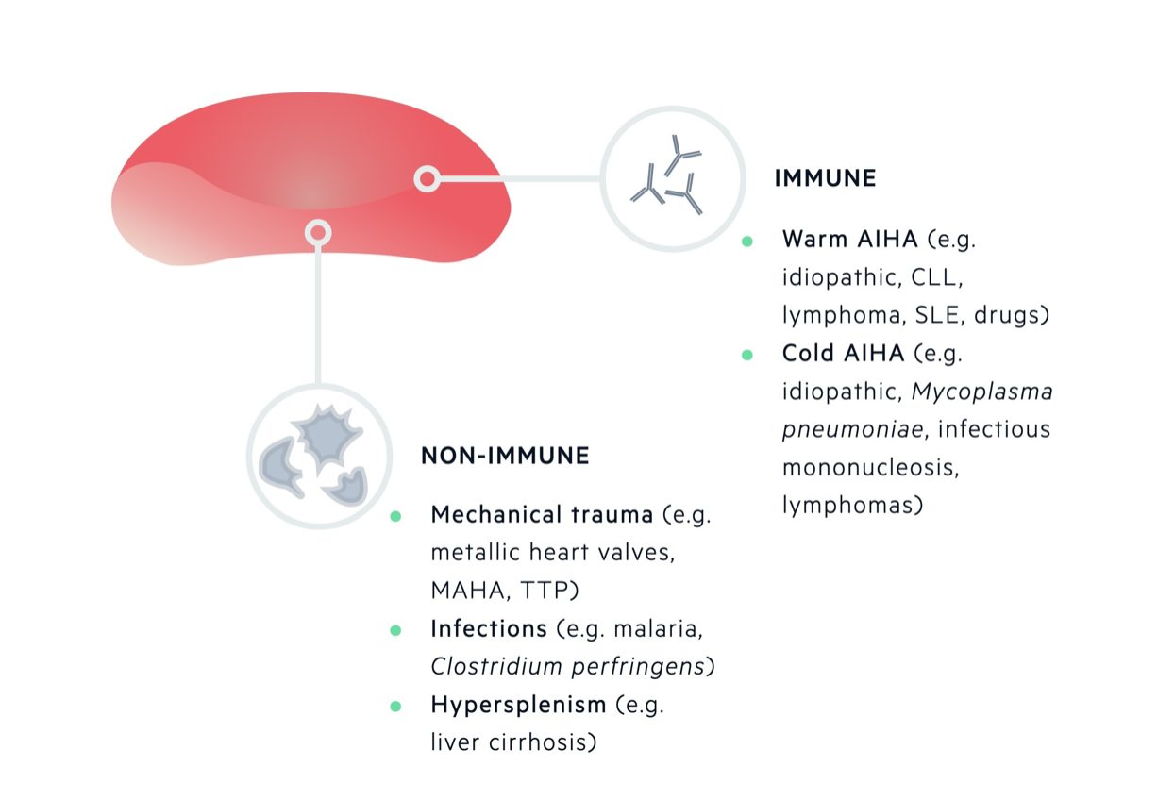

Slide 26
Blood loss
Blood loss is a common cause of anaemia, it may be obvious (e.g. trauma, haematemesis) or occult (e.g. gastrointestinal malignancy).
Erythrocytes form a major store of iron within the body. This means a loss of erythrocytes could lead to the development iron deficiency anaemia (IDA). Consequently, IDA commonly reflects blood loss from an unidentified source that requires further investigation.
Two common sources of blood loss include menstruation in young females and gastrointestinal bleeding in older populations.

Slide 27
