Slide 1

Engin KELKİTLİ MD

Slide 2
What is Anemia?
Anemia is defined by reduction in Hg Concentration, Hct Concentration or RBC count
WHO criteria is Hg < 13 in men and Hg < 12 in women
Notes:
It is a common condition that can be caused by inadequate RBC production, excessive RBC destruction, or blood loss.
Once anemia has been established, the mean corpuscular volume (MCV) should be checked to distinguish between microcytic, normocytic, and macrocytic anemia and to determine the next diagnostic steps.
A peripheral blood smear allows for the identification of pathologic RBC forms.
Reticulocyte count can also be used to evaluate the bone marrow response.
Treatment depends on the form of anemia and underlying condition.
Acute and/or severe cases of anemia may require transfusion of packed red blood cells.

Slide 3
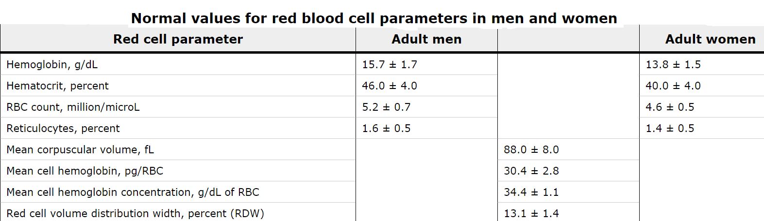

Slide 4
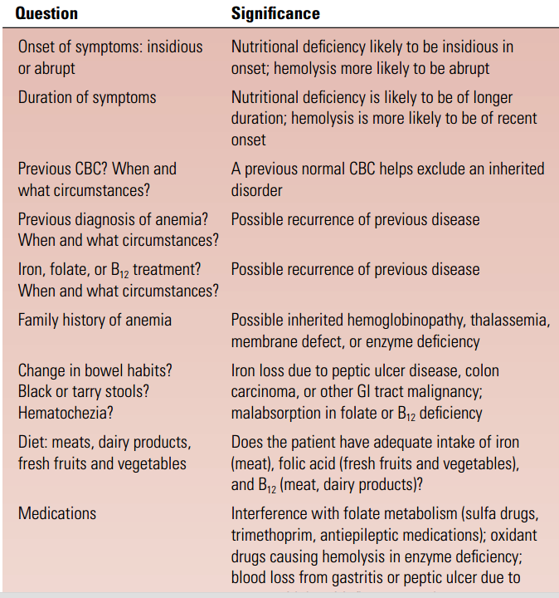
Notes:
What are the important points to consider in the history of a patient with anemia?

Slide 5
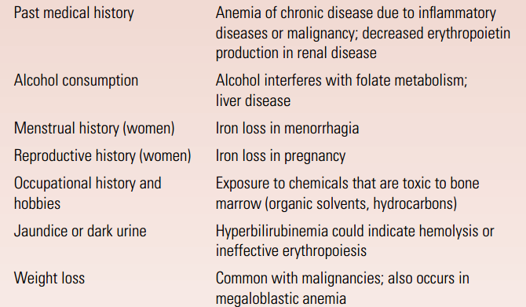
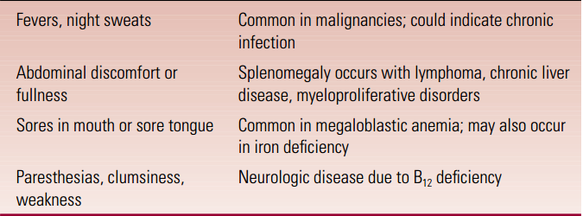

Slide 6
Symptoms
Dyspnea
Headaches
Fatigue
Roaring in the Ears
Palpitations
PICA
The severity of symptoms may vary widely depending on the degree of anemia, the time period over which anemia developed, the age of the patient, and other medical conditions that are present.

Slide 7
Pica is characterized by an appetite for substances that are largely non-nutritive, such as ice (pagophagia); hair (trichophagia); paper (papyrophagia); drywall or paint; metal (metallophagia); stones (lithophagia) or soil (geophagia); glass (hyalophagia); or feces (coprophagia); and chalk

Slide 8
Physical signs of anemia
Pallor
Pallor is best noted in the conjunctiva, mucous membranes, palmar creases, and nail beds,
Tachycardia,
Increased cardiac impulse on palpation
Systolic “flow” murmur heard at the apex and along the left sternal border,

Slide 9
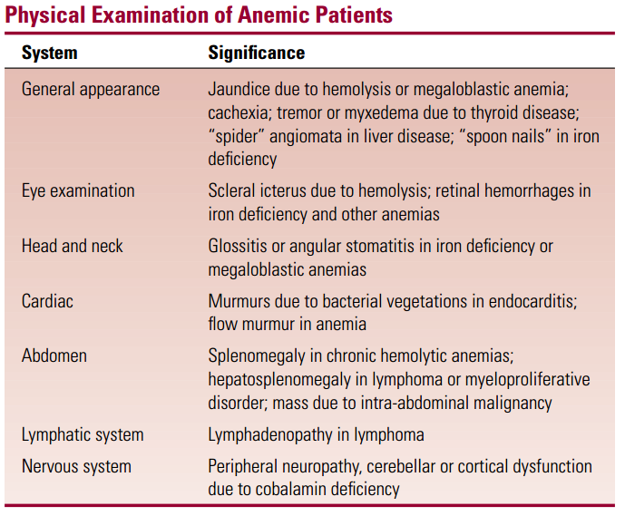

Slide 10
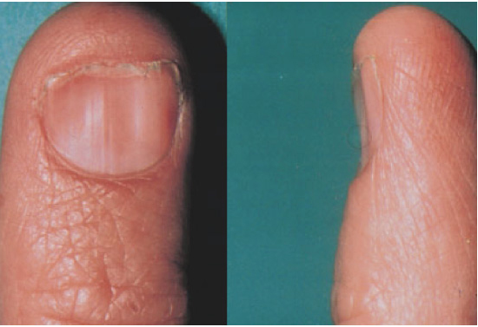
Physical Manifestation : “Spoon Nails” in Iron Deficiency

Slide 11
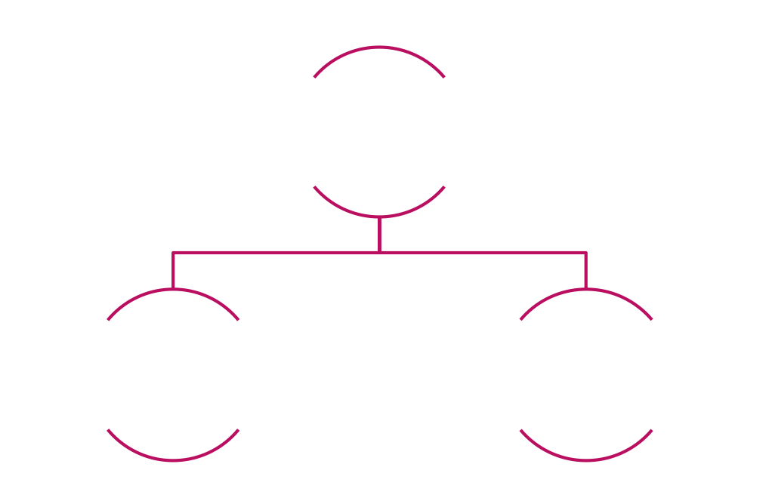
CLASSIFICATION OF ANEMIA
Anemia can be approached from two perspectives:
Notes:
(also called functional or kinetic).
Anemia may be classified into several subtypes

Slide 12
Kinetic Approach
Decreased RBC production
Lack of nutrients (B12, folate, iron)
Bone Marrow Disorder
Bone Marrow Suppression
Increased RBC destruction
Inherited and Acquired Hemolytic Anemias
Blood Loss

Slide 13
Morphological Approach
Microcytic (MCV < 80)
Reduced iron availability
Reduced heme synthesis
Reduced globin production
Normocytic ( 80 < MCV < 100)
Macrocytic (MCV > 100)
Liver disease, B12, folate
Notes:
MCV is the most important initial test in the diagnostic workup.

Slide 14







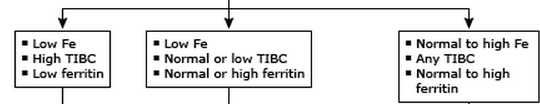




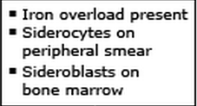
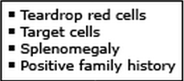






Notes:
high ferritin is a very important parameter in the distinction between iron deficiency anemia and chronic disease anemia.

Slide 15
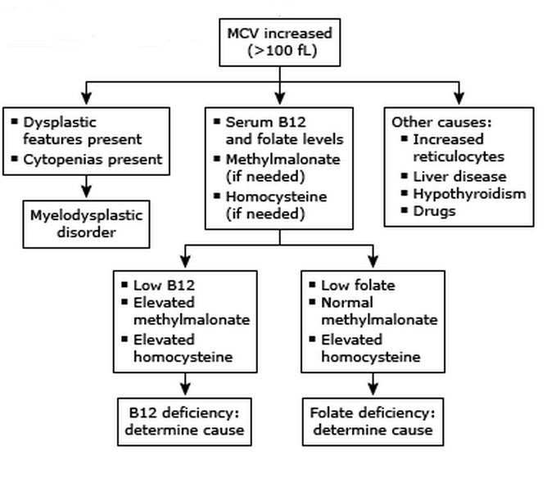

Slide 16
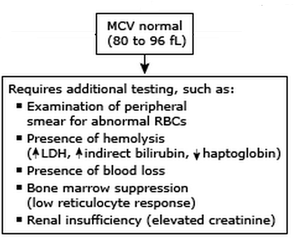

Slide 17
Reticulocyte Count:
The reticulocyte count is the proportion (percent) of young erythrocytes containing ribonucleic acid (RNA), which can be visually identified as reticulin using a special stain such as new methylene blue.
The normal reticulocyte count is approximately 1%.
Increased reticulocyte count is the primary indicator of increased RBC production.

Slide 18
Example: A patient is found to have a hematocrit of 15% and reticulocyte count of 10%.
Calculate the corrected reticulocyte count:
Corrected reticulocyte count =
10 . (15:45) = 3.3%

Slide 19
Peripheral blood smear
Manual examination of a peripheral blood sample under a microscope
May reveal classic pathologic RBC forms, which can be used to identify certain types of anemia that automated RBC indices cannot (e.g., schistocytes in hemolytic anemia)

Slide 20
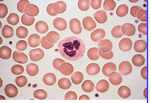
Normal Peripheral Smear

Slide 21
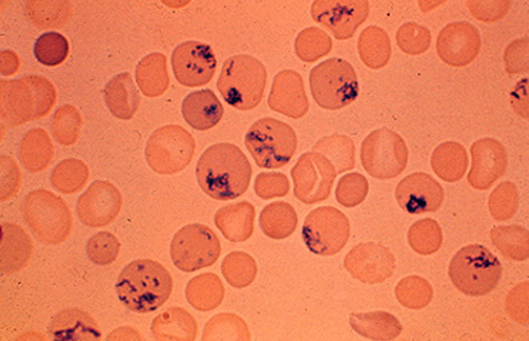
Reticulocytes

Slide 22
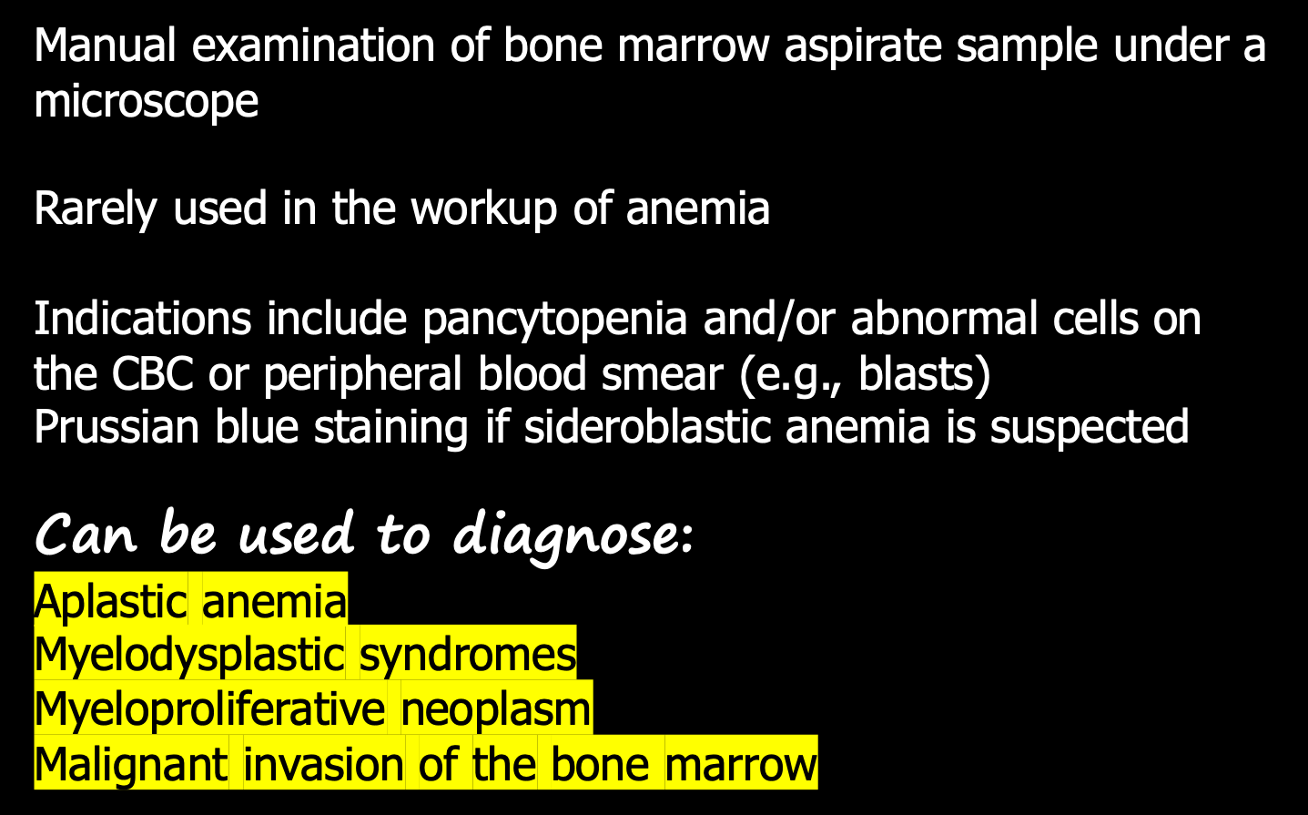
Bone marrow biopsy

Slide 23
SUMMARY
Anemia is defined as a decrease in the quantity of circulating red blood cells (RBC), represented by a reduction in hemoglobin concentration (Hb), hematocrit (Hct), or RBC count.
Clinical features, if present, are mostly nonspecific and may include fatigue, dyspnea, conjunctival pallor, and tachycardia.
Once anemia has been established, the mean corpuscular volume (MCV) should be checked to distinguish between microcytic, normocytic, and macrocytic anemia and to determine the next diagnostic steps.
A peripheral blood smear allows for the identification of pathologic RBC forms. Reticulocyte count can also be used to evaluate the bone marrow response.
Treatment depends on the form of anemia and underlying condition. Acute and/or severe cases of anemia may require transfusion of packed red blood cells.

Slide 24
Nutritional Anemia
Doç.Dr.Engin KELKİTLİ
www.enginkelkitli.com

Slide 25
Nutritional anemia
Iron Deficiency anemia
Vit B12
Folic Acid
Vit C
Copper
…

Slide 26
Iron Deficiency Anemia
Iron deficiency is the most common cause of anemia.
Note that iron deficiency is not synonymous with iron deficiency anemia.
Anemia is a late manifestation of iron deficiency; marrow iron stores will be totally consumed before the hemoglobin begins to decrease.
The absence of microcytosis does not exclude anemia due to iron deficiency!

Slide 27
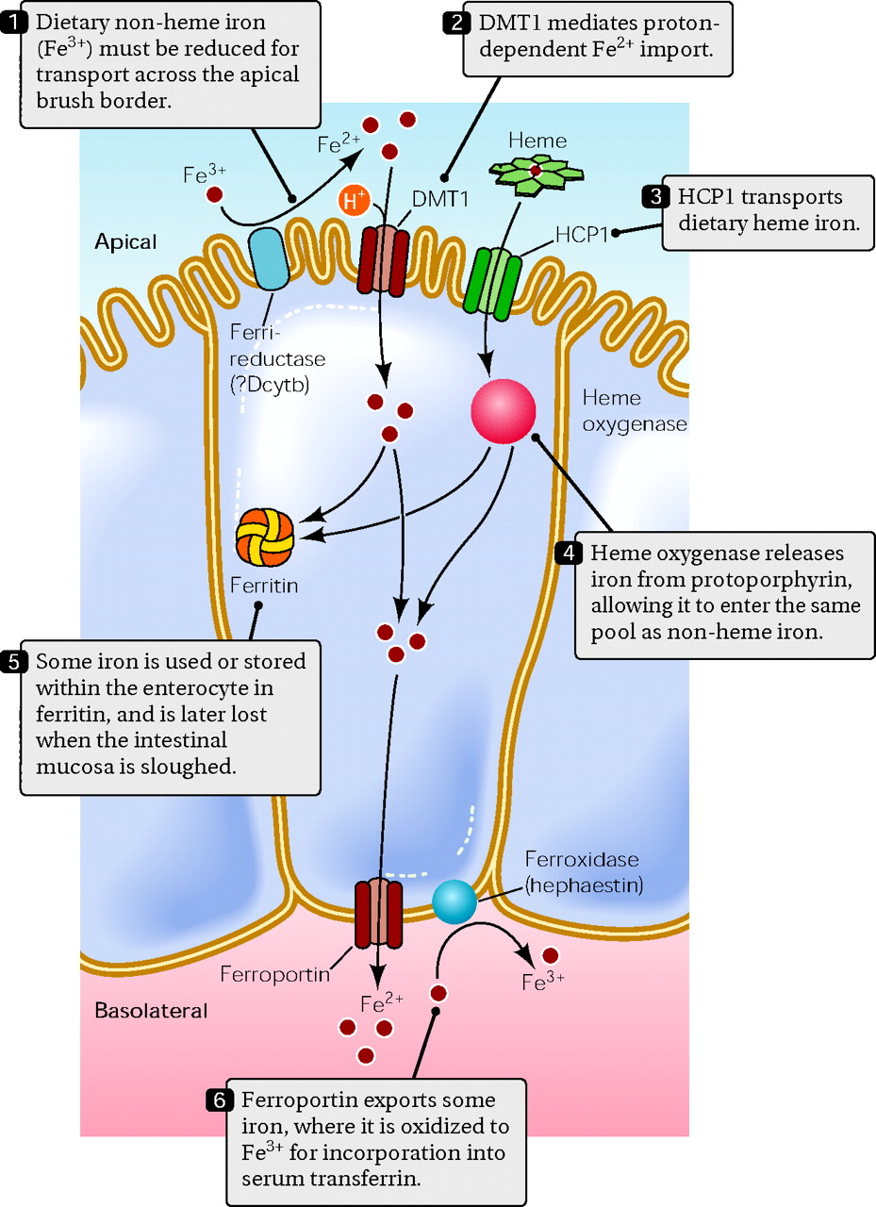
Donovan, A. et al. Physiology 21: 115-123 2006;

Slide 28
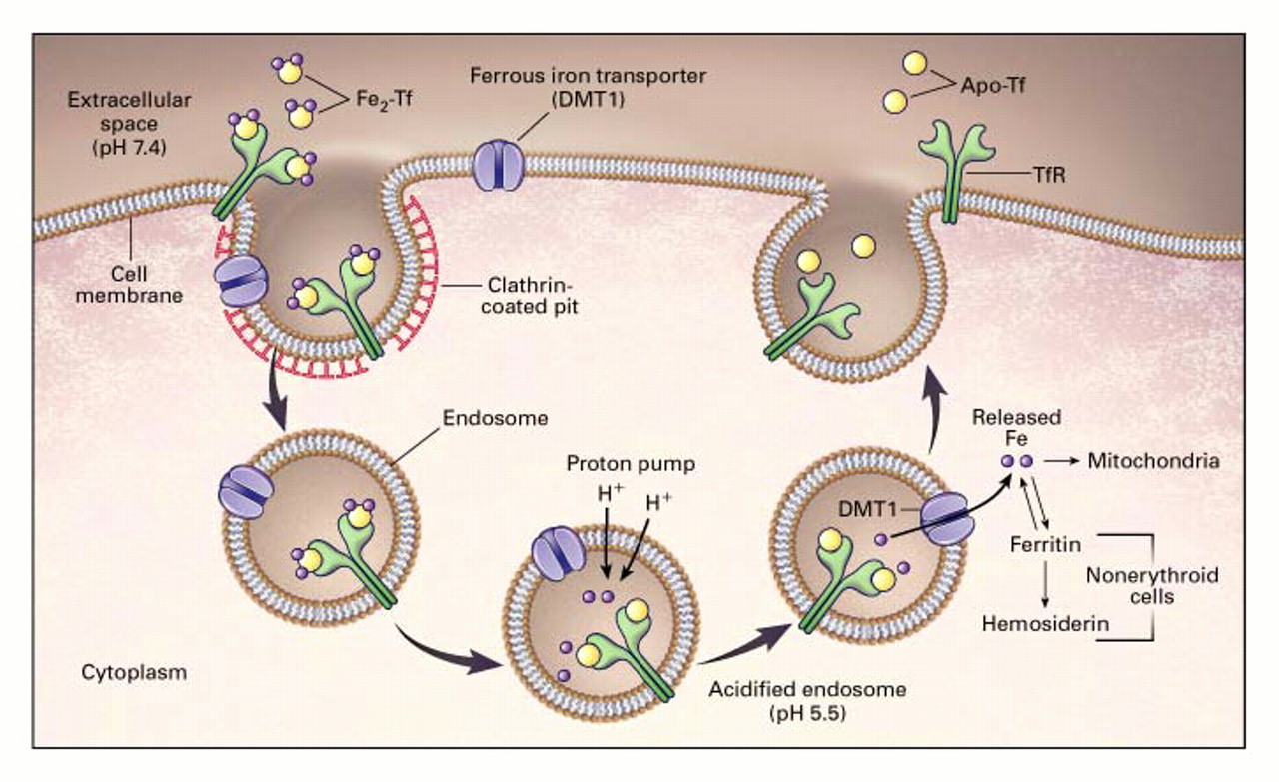

Andrews N. N Engl J Med 1999;341:1986-1995
Notes:
Figure 2. The Transferrin Cycle.
Iron-laden transferrin (Fe2-Tf) binds to transferrin receptors (TfR) on the surface of erythroid precursors. These complexes localize to clathrin-coated pits, which invaginate to form specialized endosomes.2 A proton pump decreases the pH within the endosomes, leading to conformational changes in proteins that result in the release of iron from transferrin. The iron transporter DMT1 moves iron across the endosomal membrane, to enter the cytoplasm.3 Meanwhile, transferrin (Apo-Tf) and transferrin receptor are recycled to the cell surface, where each can be used for further cycles of iron binding and iron uptake. In erythroid cells, most iron moves into mitochondria, where it is incorporated into protoporphyrin to make heme. In nonerythroid cells, iron is stored as ferritin and hemosiderin.

Slide 29
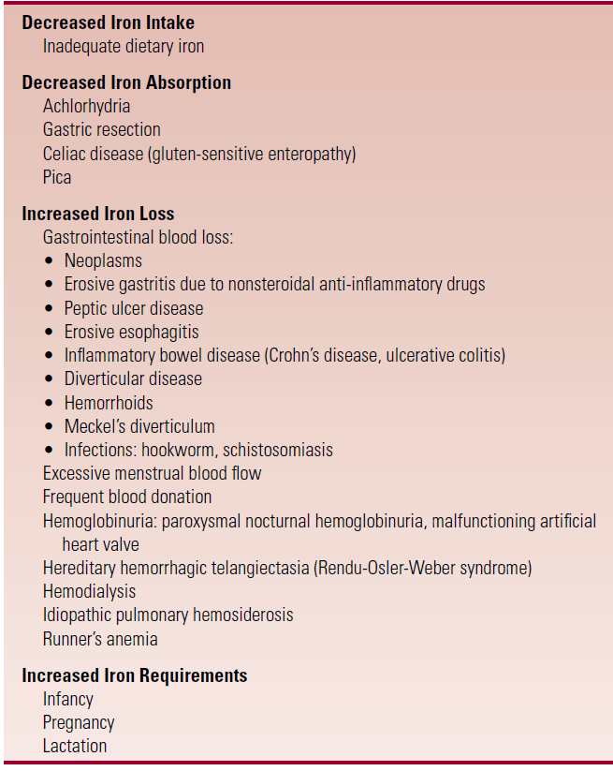
Causes of Iron Deficiency

Slide 30
Clinical Features
In general, the symptoms of iron deficiency anemia are those of anemia of any cause.
--“Spoon”fingernails -- Glossitis (atrophy of the papillae of the tongue, with burning or soreness) -- Ulcerations or fissures at the corners of the mouth (angular stomatitis) --Dysphagia due to esophageal webs or strictures.
--Pica is the habitual consumption of unusual substances
Dysphagia + angular stomatitis + hypochromic anemia
Plummer-Vinson or Paterson-Kelly syndrome

Slide 31
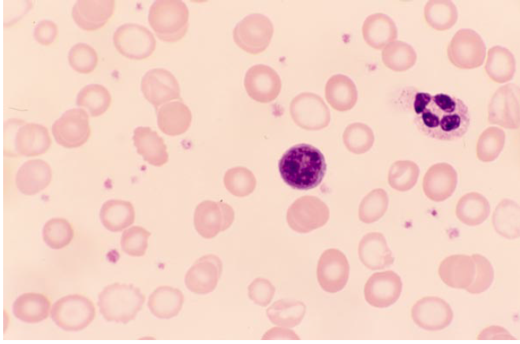
Laboratories
The single most efficient test to assess body iron stores is the serum ferritin.
A low serum ferritin (less than 15 ng/mL or 15 g/L) is strong evidence for iron deficiency, with or without inflammation.
A serum ferritin that is increased or high in the normal range (greater than ~150–200 ng/mL or 150–200 g/L) is strong evidence against iron deficiency, whether or not there is inflammation.

Slide 32
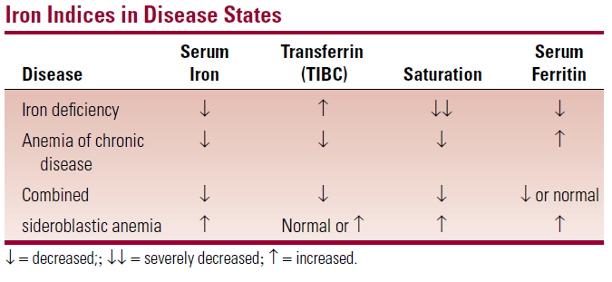

Slide 33
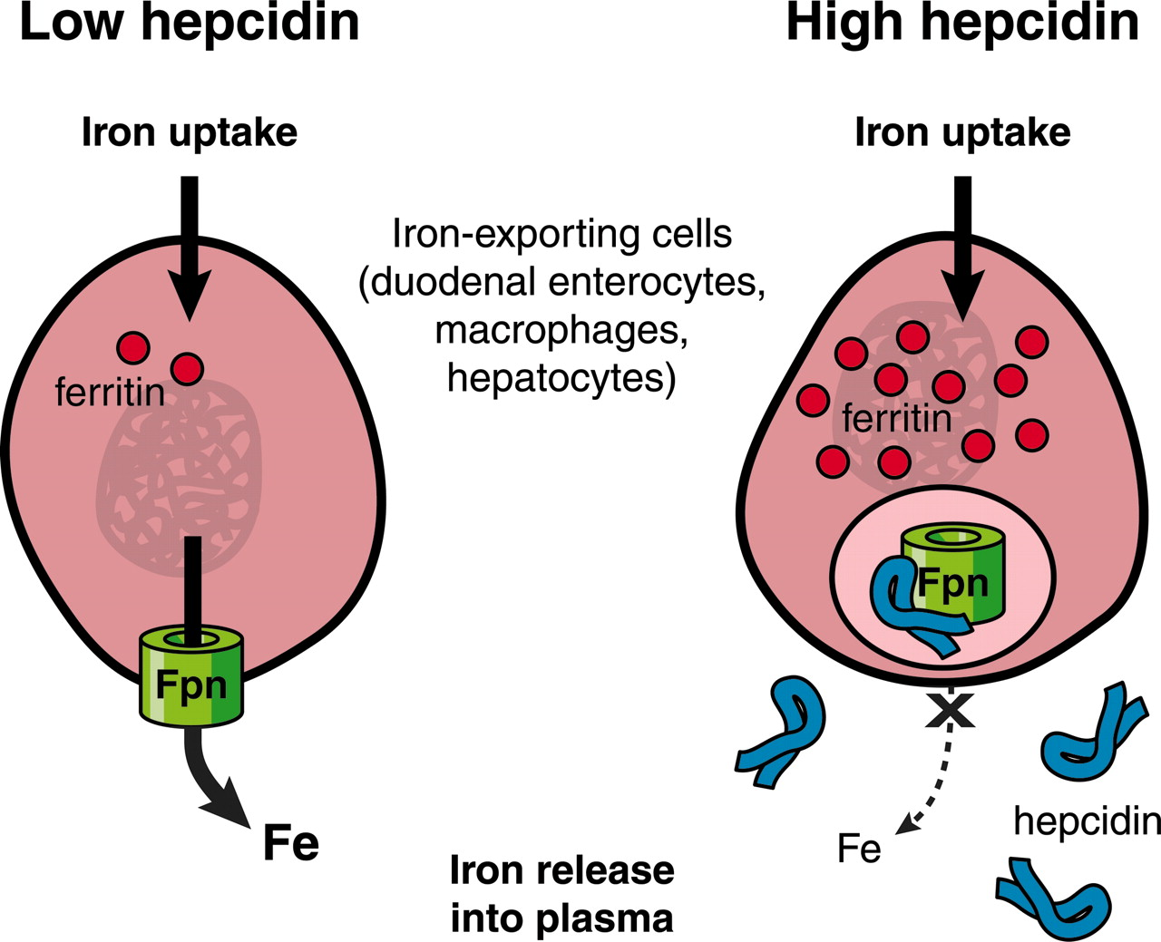

Slide 34
Treatment of Iron Deficiency
Any primary cause of iron deficiency (excessive menstrual blood loss, gastrointestinal neoplasm) should be treated appropriately.
The most effective and inexpensive way to replace iron stores is iron supplements given orally.
In general, oral supplementation is the treatment of choice unless there is a significant GI condition that precludes absorption of iron.
Parenteral iron administration can be done but is much more expensive than oral therapy and has potential side effects.

Slide 35
Oral Iron Replacement
Ferrous (Fe2+) iron salts are the least expensive way to give iron orally.
Various preparations are available.
The aim is to give approximately 200 mg of elemental iron daily for adults.
Side effects of oral iron therapy heartburn, nausea, abdominal cramps, and diarrhea or constipation.
The patient should be warned that the stool will become black.
It is important to monitor the response to therapy.

Slide 36
The reticulocyte count should increase within 5 to 10 days and the hemoglobin should increase by about 2 g/dL within 3 to 4 weeks.
Failure to respond appropriately suggests that
The diagnosis of iron deficiency was incorrect,
There is some complicating factor (such as cobalamin or folate deficiency
Anemia of chronic disease
GI disease that prevents adequate iron absorption, or continuing blood loss)
There is failure to comply with the therapy.
• It is important to continue iron therapy for 3 to 6 months after the hemoglobin returns to normal to replenish body iron stores.

Slide 37
Parenteral Iron Therapy
Indications
Inability to tolerate oral therapy
Continuing blood loss faster than can be compensated for with oral therapy
GI disease such as ulcerative colitis that prevents iron absorption or that would be aggravated by oral therapy.
Parenteral therapy is significantly more expensive than oral therapy and may have serious side effects.
-Hemoglobin iron deficit= [weight (kg)x (14 - Hgb) x (2.145)] (men pulse 1000 women pulse 500)

Slide 38
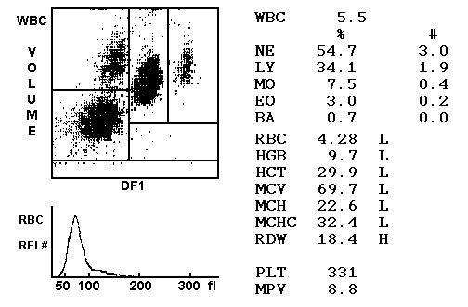

Slide 39
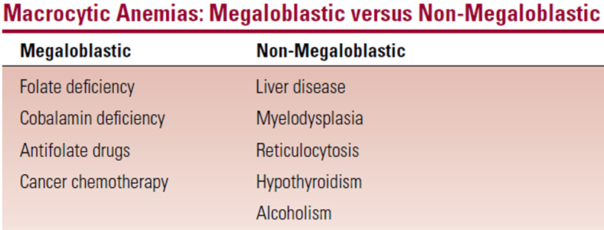
THE MEGALOBLASTIC ANEMIAS: COBALAMIN (VITAMIN B12) AND FOLATE DEFICIENCIES

Slide 40
VİT B12
Terminal İleum
The primary dietary sources of cobalamin are meat, eggs, milk, and cheese.
The daily requirement is ~0.1 micg/day.

Slide 41
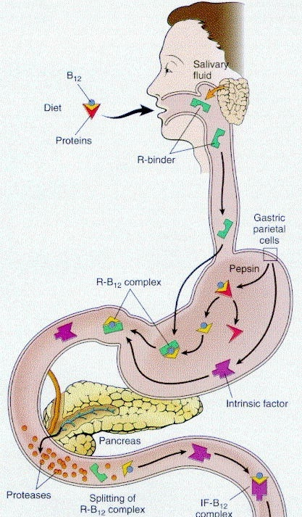

Slide 42
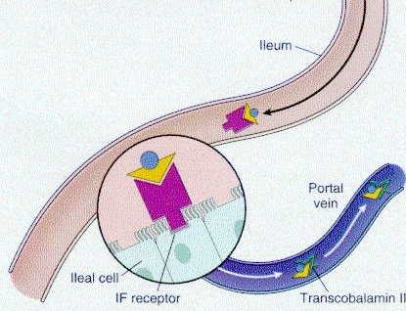

Slide 43
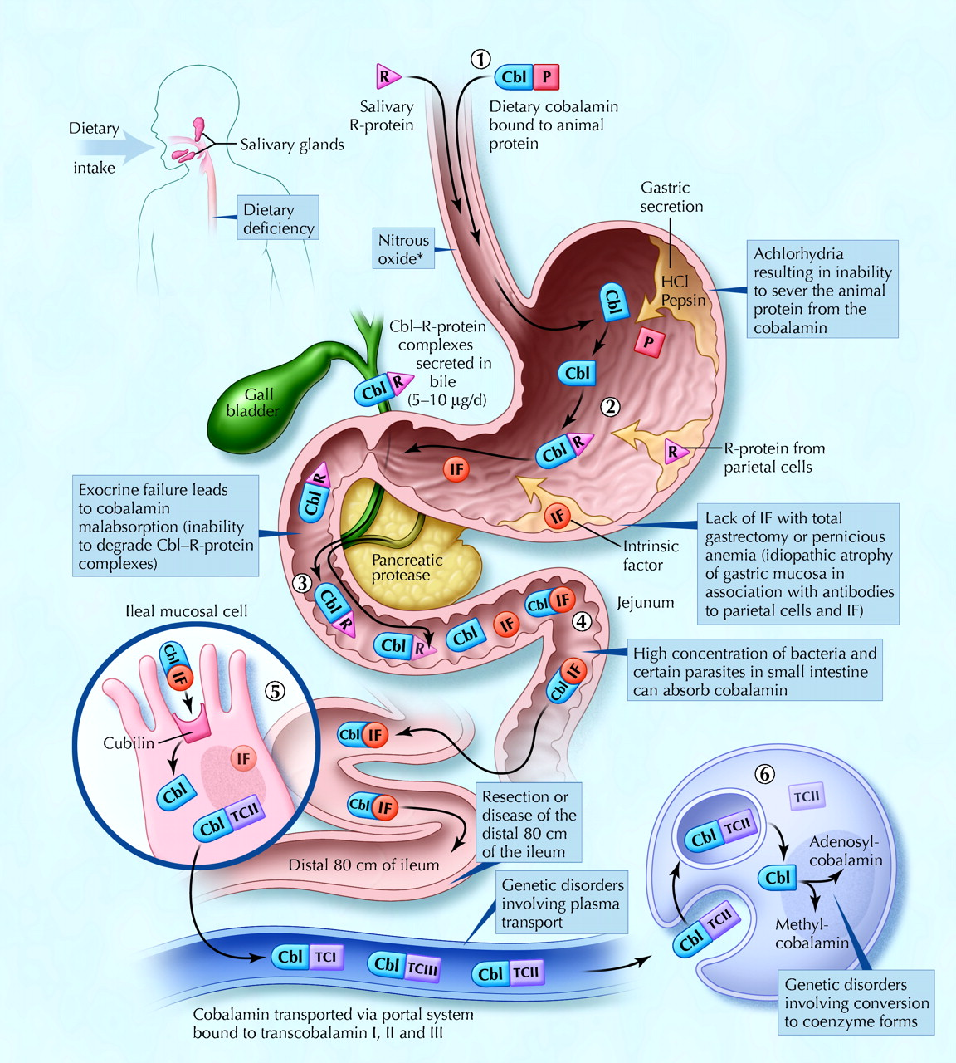

Cobalamin metabolism and corresponding causes of deficiency
Andres, E. et al. CMAJ 2004;171:251-259
Copyright ©2004 CMA Media Inc. or its licensors

Slide 44
Folic Acid
Folic acid (folate) is actually pteroylglutamic acid.
Folic acid is required for the transfer of one-carbon fragments such as methyl groups in numerous chemical reactions.
it is abundant in vegetables, fruit, cereals, and dairy products.
Folic acid is heat labile, and much is destroyed by cooking.
Therefore, the primary dietary source for folic acid is fresh uncooked fruits and vegetables.
Primarily absorbed in the jejunum. The daily requirement is ~50 mg.

Slide 45
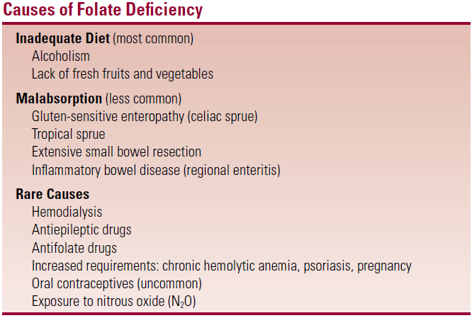
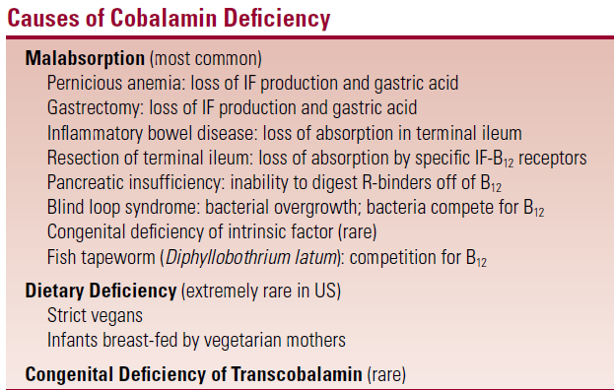

Slide 46
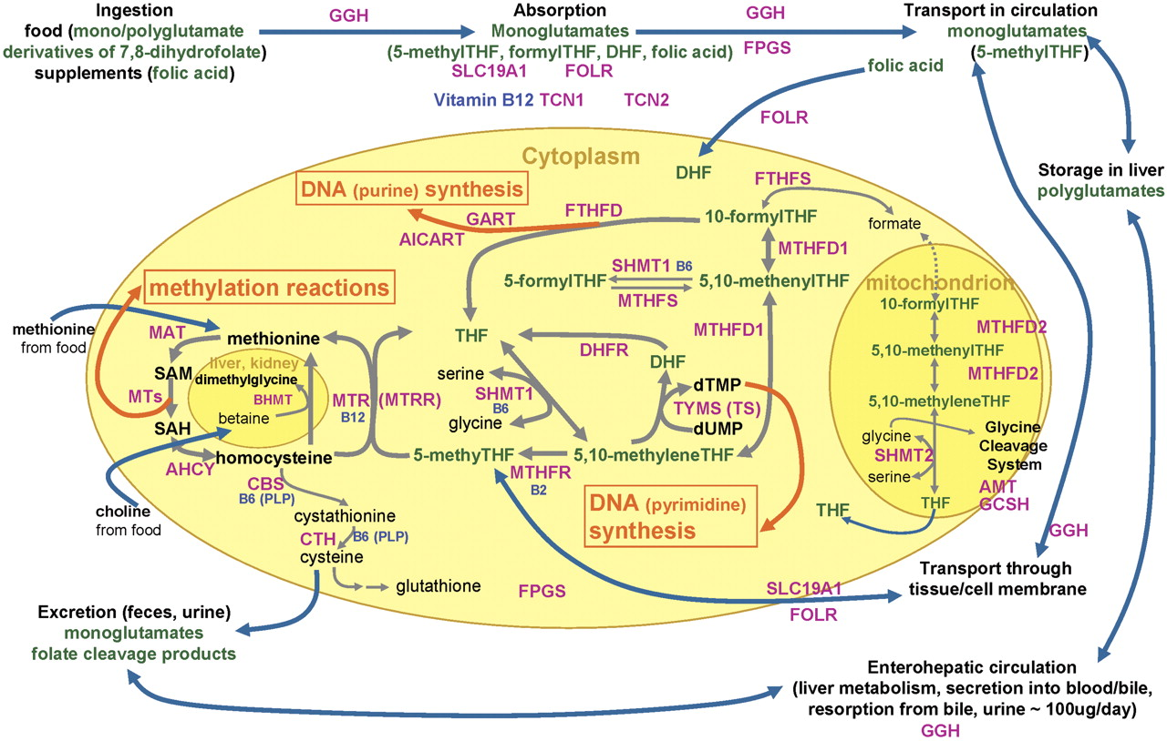

Slide 47
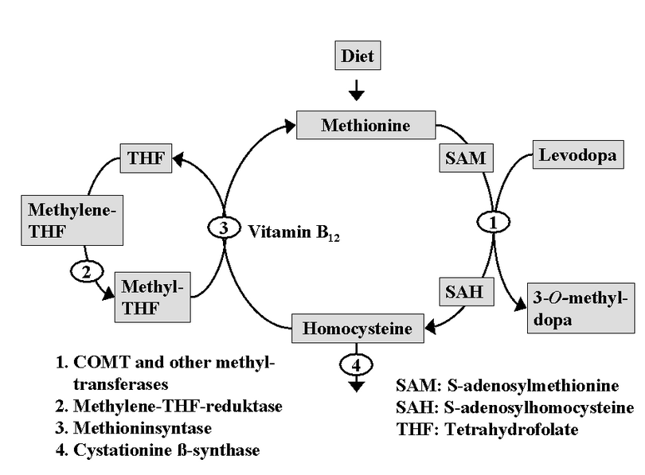
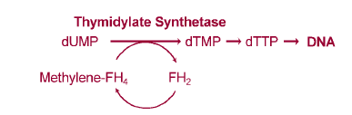

Slide 48
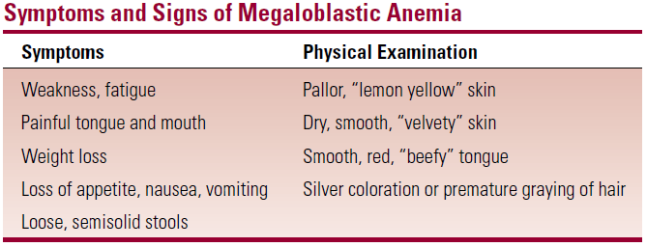

Slide 49
Neurologic Disease in Cobalamin Deficiency
Cobalamin deficiency may be complicated by neurologic disease, a feature that separates cobalamin from folate deficiencies.
The degree of neurologic disorder does not correlate with the degree of anemia.
Patients may have severe neurologic disease without significant hematologic abnormalities.
The primary neuropathologic change in cobalamin deficiency is demyelination of the dorsal and lateral columns of the spinal cord and the cerebral cortex.
Both sensory and motor systems are affected, leading to the terms subacute combined degeneration and combined system disease.

Slide 50
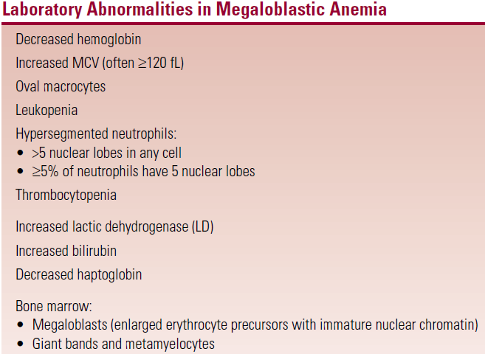
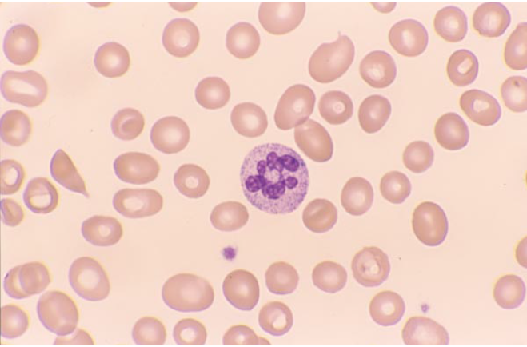
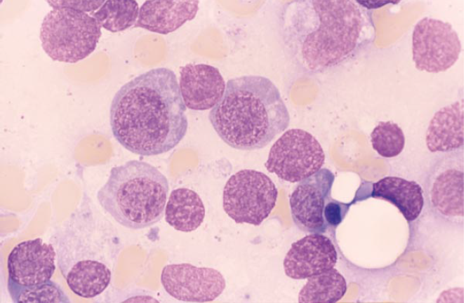
Laboratory Evaluation

Slide 51
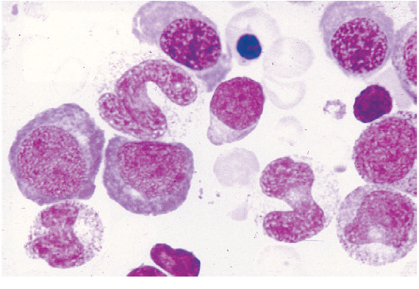

Slide 52
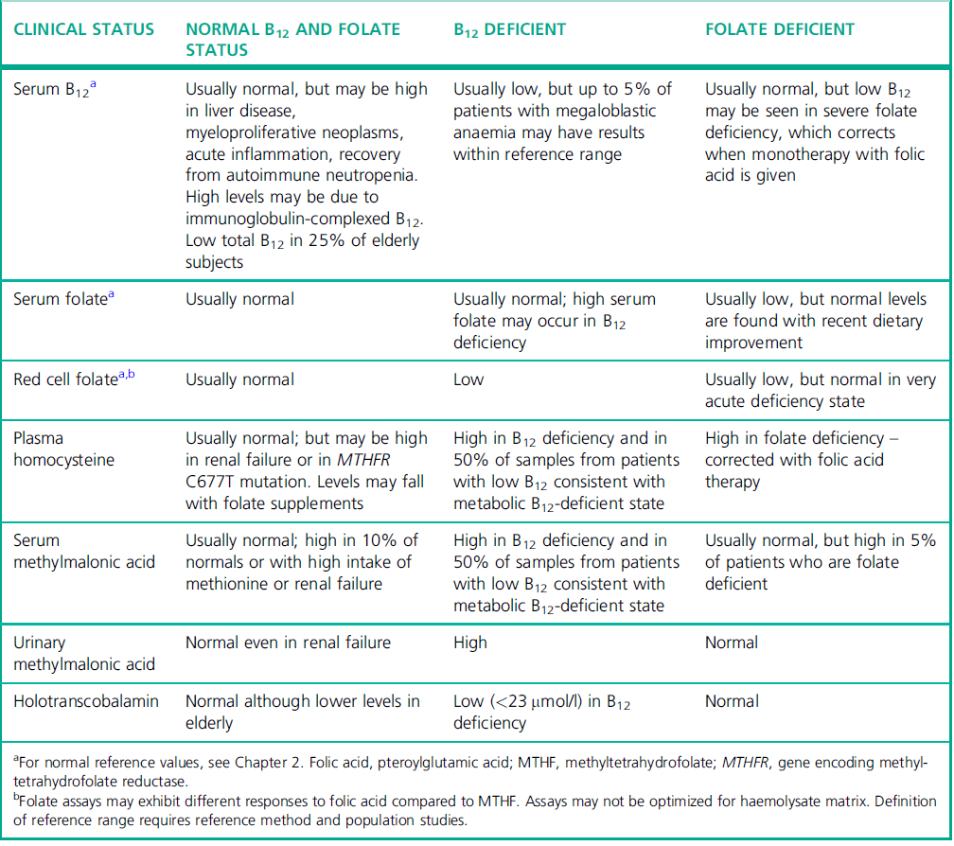

Slide 53
Treatment of Megaloblastic Anemia
It is critical to determine whether the deficiency is due to folic acid or cobalamin; giving the wrong treatment is ineffective and potentially dangerous.
Oral folate supplementation is the treatment of choice for most cases of folate deficiency.
Available preparations include cyanocobalamin and hydroxocobalamin.
A typical treatment regimen would be 1,000 micg (1 mg) of cyanocobalamin for 10 days, followed by 1,000 g monthly for life.
It is critical that once cobalamin deficiency is documented, therapy must be continued for life.
Treatment of cobalamin deficiency with folic acid may accelerate the progression of neurologic disease.

Slide 54
Monitor the response to therapy
Reticulocytosis should appear after about 2 to 3 days, with a maximum response at 5 to 8 days.
The hemoglobin should begin to rise after about 1 week, with normalization of the hemoglobin by 4 to 8 weeks.
The granulocyte count usually reaches a normal level within 1 week; hypersegmentation of neutrophils usually disappears within 2 weeks.
The platelet count usually returns to normal within 1 week.
The bone marrow shows dramatic improvement, with disappearance of megaloblasts within 1 to 2 days.
The serum LD and bilirubin drop rapidly.

